Slide 1

VITA Lab
Building instance segmentation and building type detection
Yaxiong Luo, Master thesis, 30 credits
Electrical & Electronic Engineering
Supervisor: Prof. Alexandre Massoud Alahi
Assistant: Saeed Saadatnejad, Alireza Khodaverdian
Expert: Athanasios Papadopoulos, ETH
2021/07/28

Slide 2
Content
Introduction
Approach
Related work
Experiment detail
Conclusion and future work

Slide 3
Introduction

Slide 4
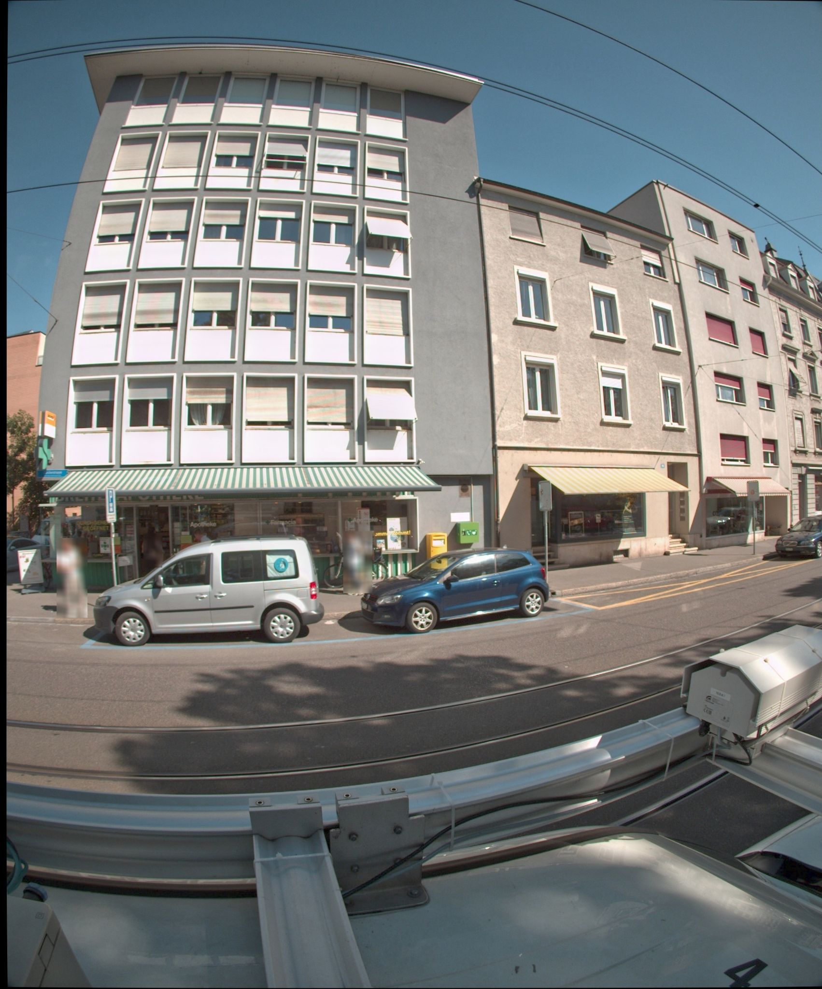
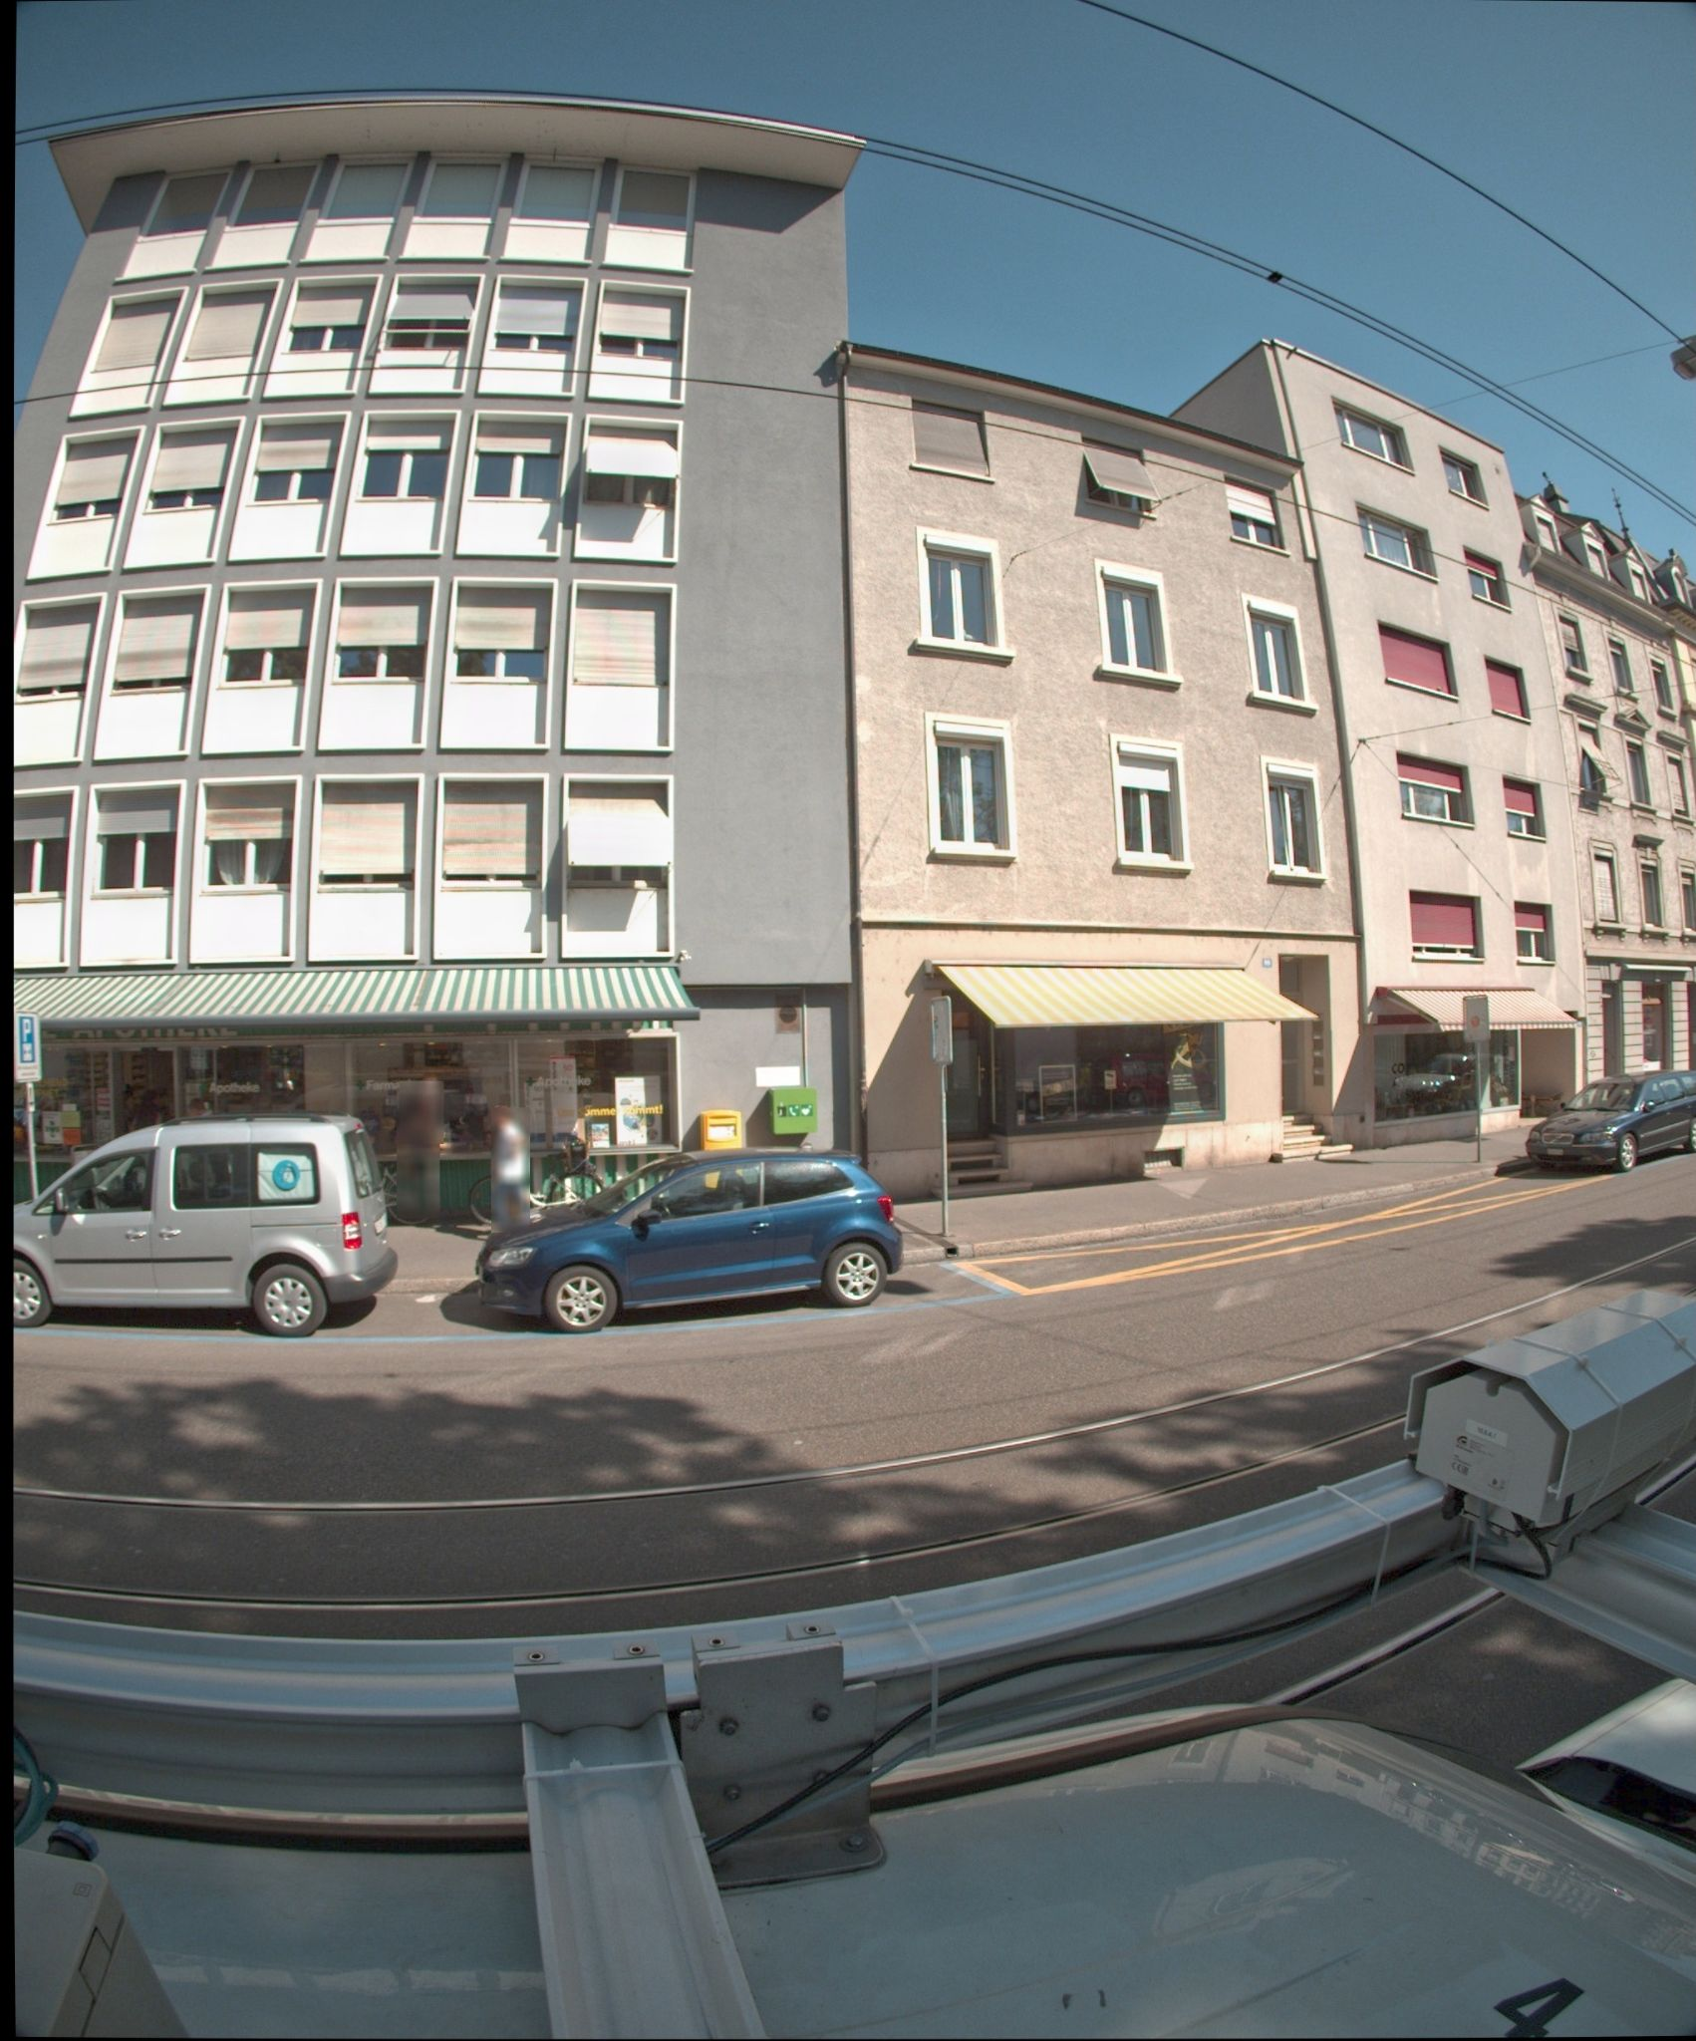
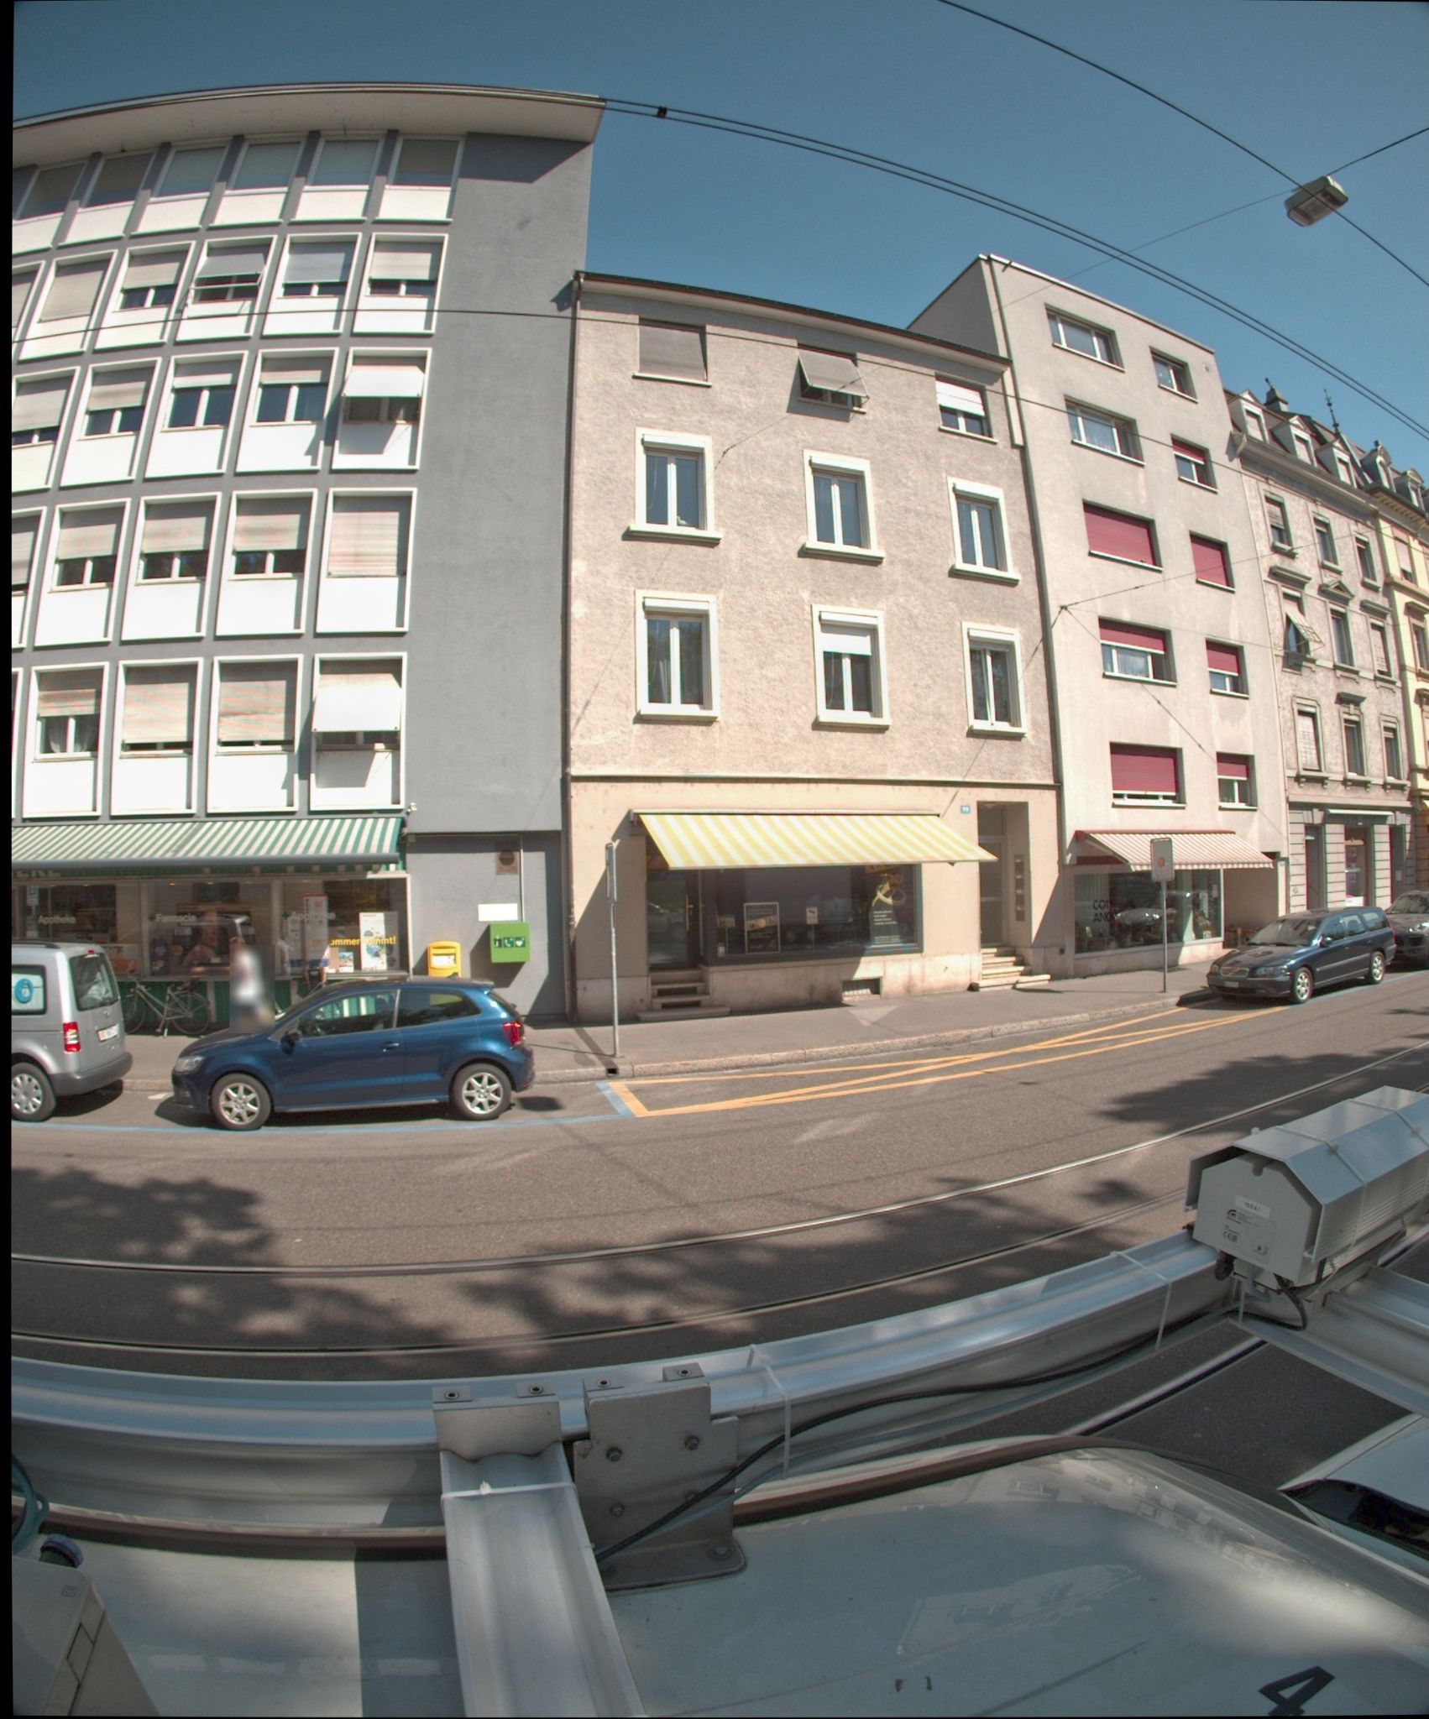
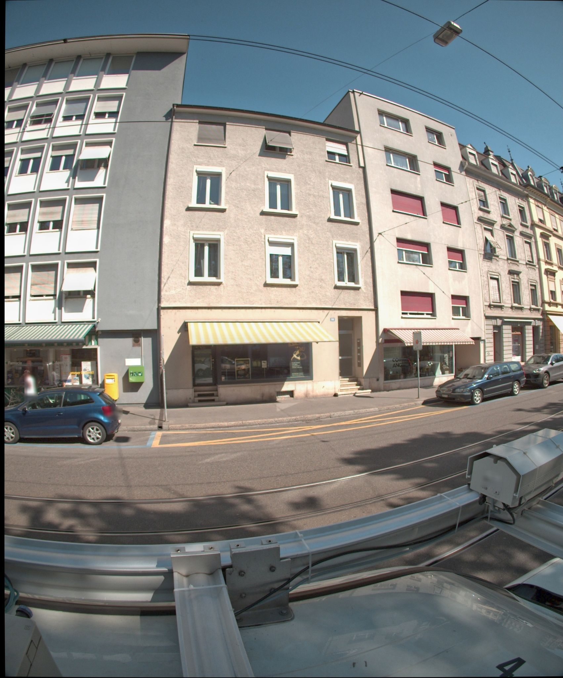
Dataset
Building image dataset
Street view building images from Basel, taken from a panorama camera
One street is divided into several segment. Images are grouped by segment number. For each segment, it has many frames
Image frames from one segment

Slide 5
Problem Statement
Use image recognition and deep learning techniques to do several tasks on the building image dataset
Detect the building instances and opengings (window and door)
Estimate the number of building floor and differences in floor height of adjacent buildings
Detect the building type
Find the distribution of the buildings
Notes:
This project can help the government know the distribution of buildings and building type ratio，and can be useful for government to do the risk assessment.

Slide 6
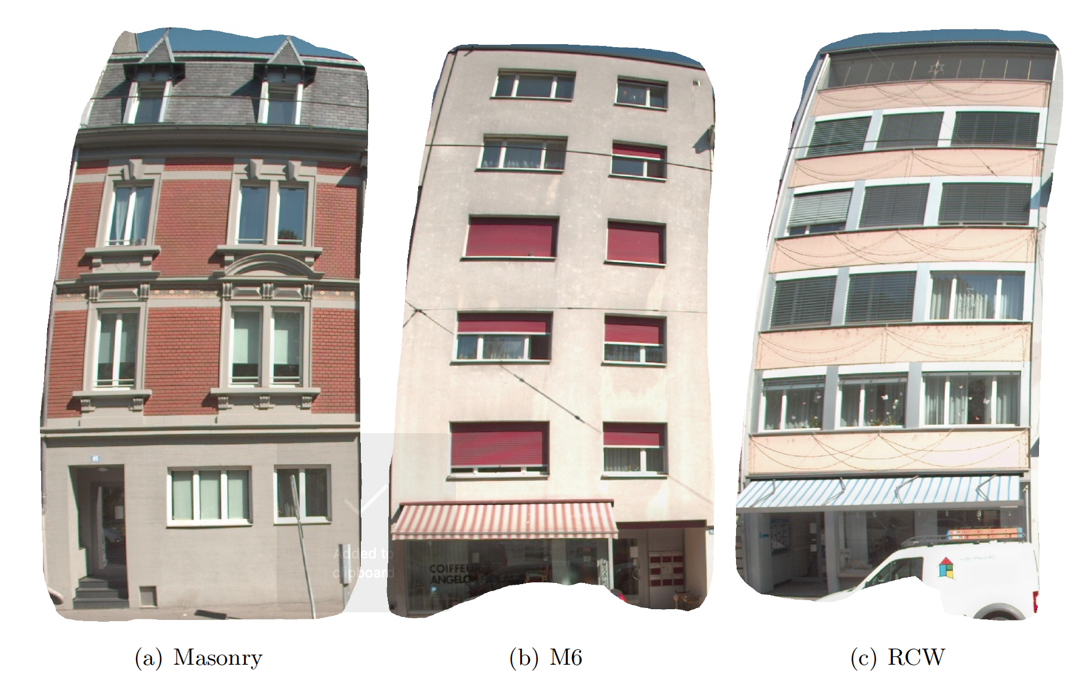
Building type
In our project, we consider to predict three building types:
Masonry: stone
M6: concrete block
RCW: reinforced concrete wall

Slide 7
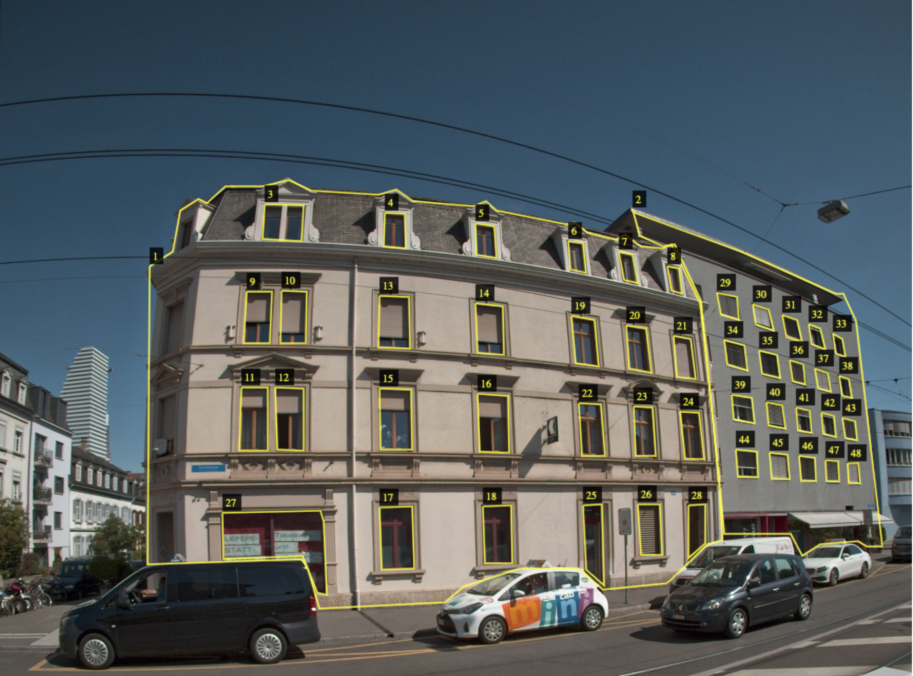
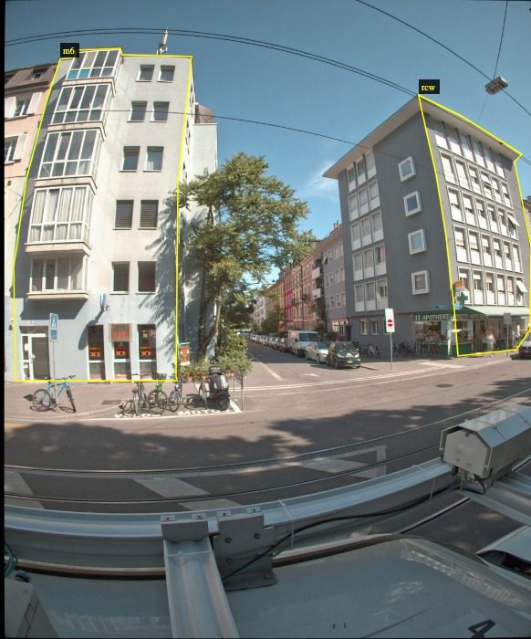
Annotation
Use VGG Image Annotator to annotate images. We have two types of labeling
Annotate ‘building’ and ‘opening’
Annotate ‘Masonry’, ‘M6’ and ‘RCW’

Slide 8
Approach

Slide 9
Approach
Model 1: Cascaded
Detect floor
Floor level
Images
Model:
Mask-RCNN
Building Instances and openings
Threshold of Opening/facade
Building type
Model 2: Multi-task
Images
Model:
Mask-RCNN
Building Instances and types
Model: Duplication detection
Building Instances
Keypoint matching and DBSCAN clustering
Distinct buildings
Building number
Notes:
Deep learning and trhreshold

Slide 10
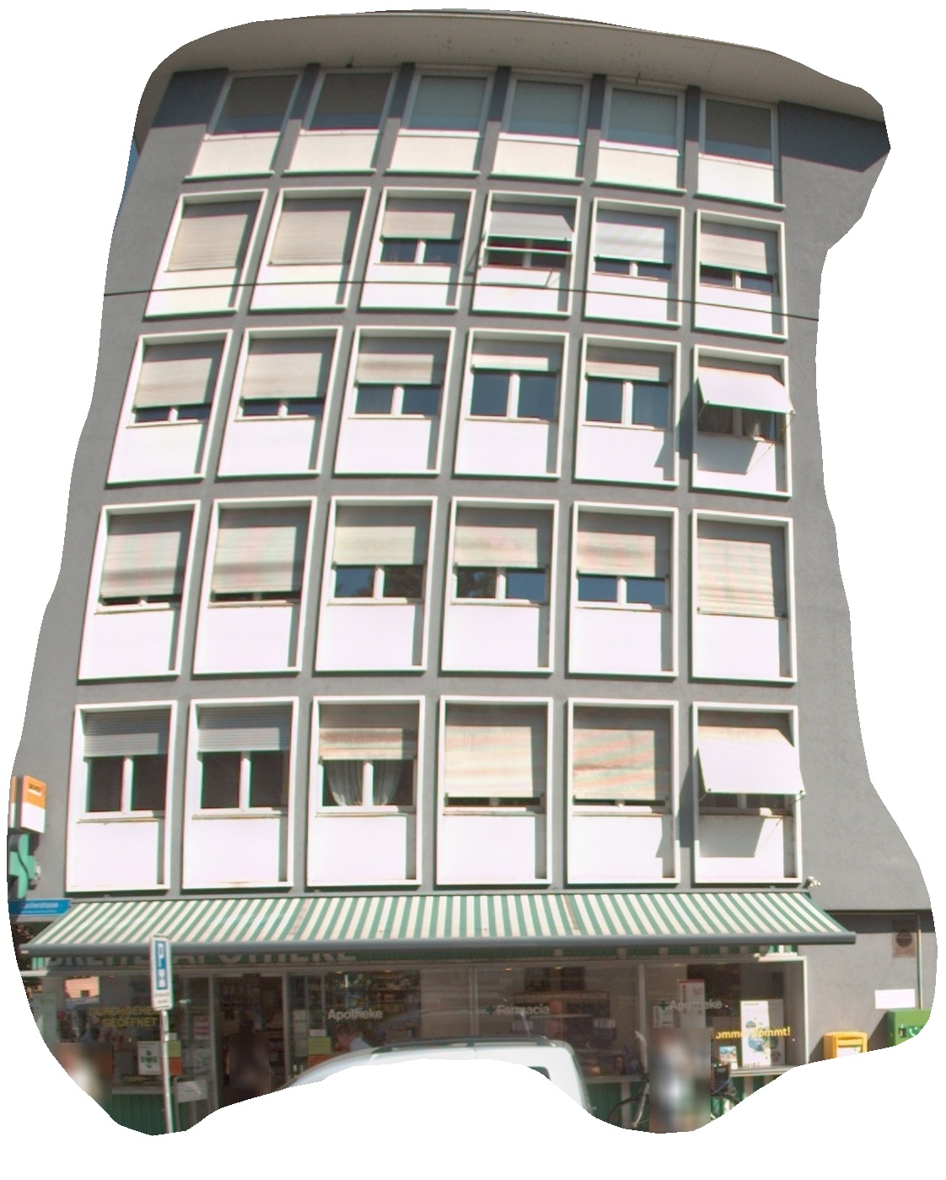
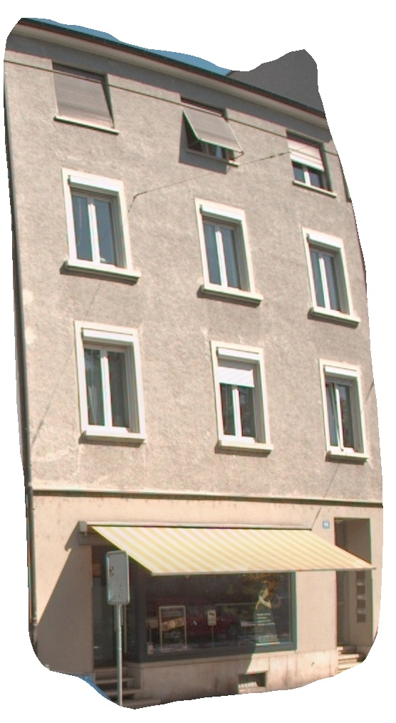
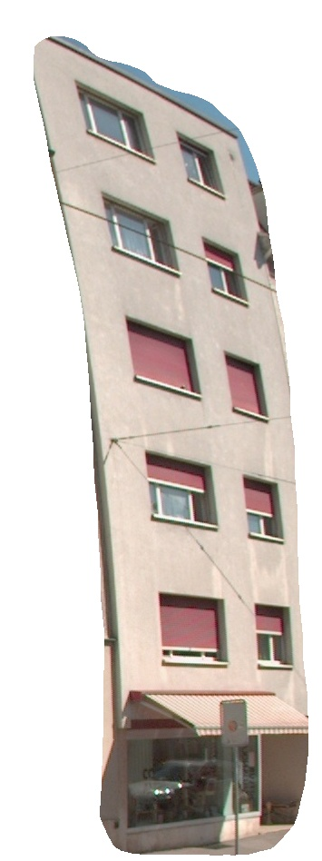
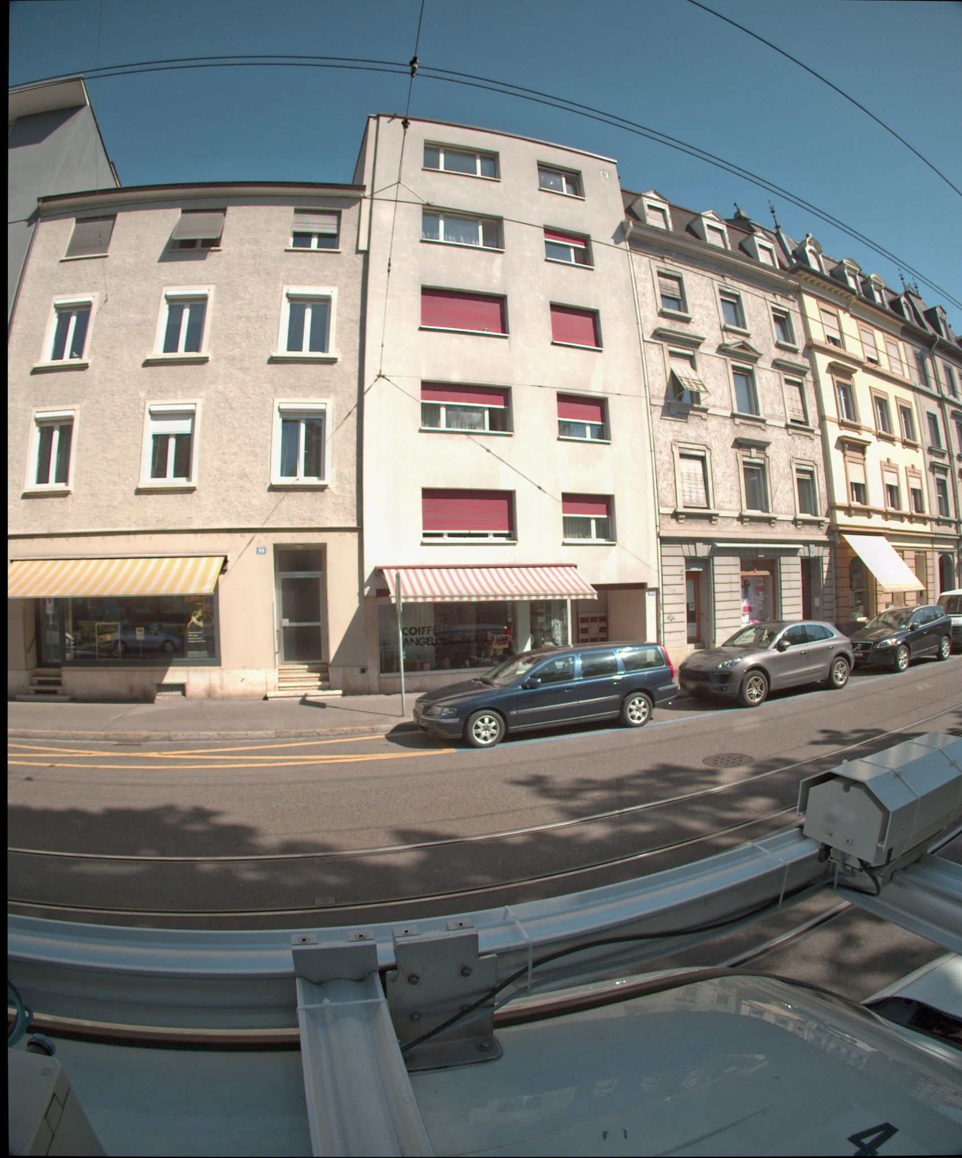
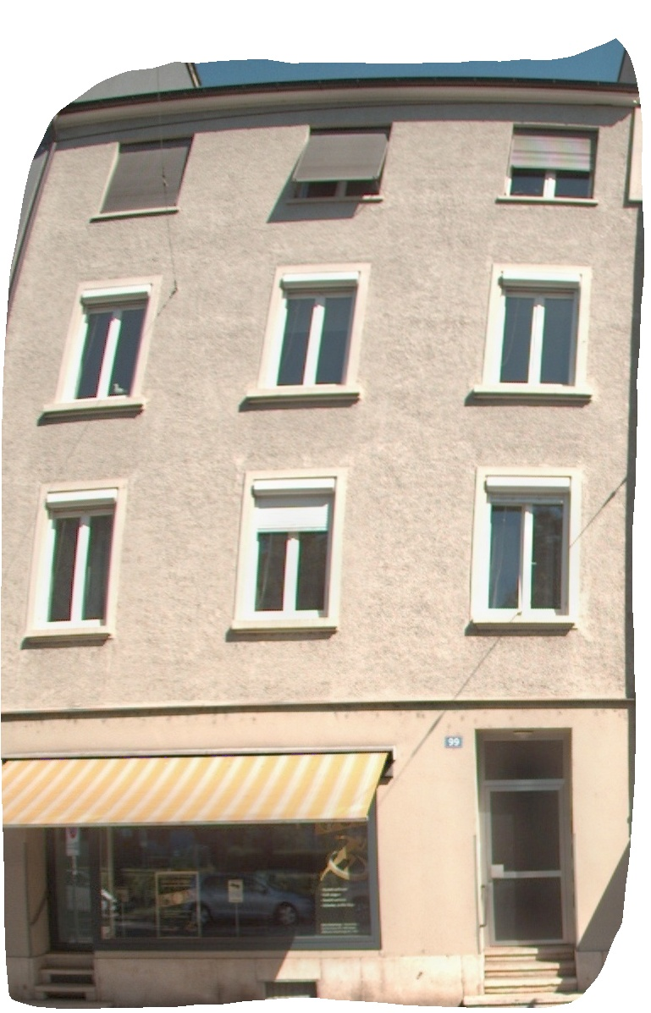
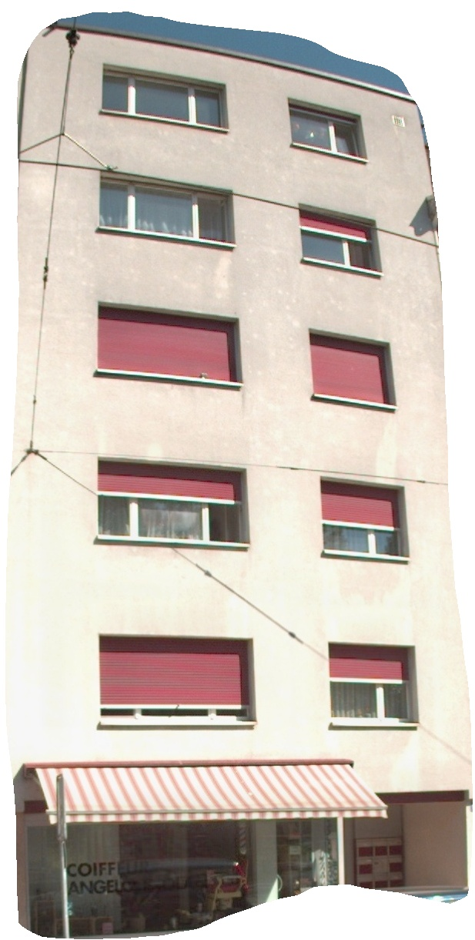
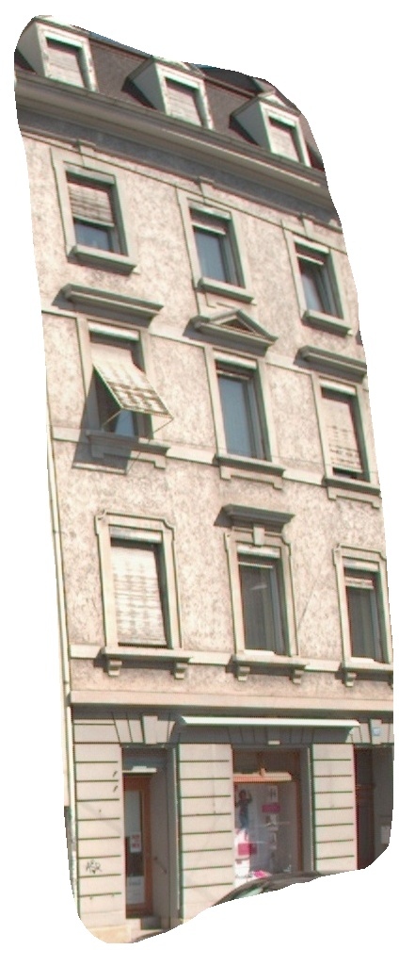
Approach Example
Building instances
Duplication and building number
Input images
4 buildings
a.1
a.2=b.1
a.3=b.3
b.3
Image (a)
a.1
a.2
a.3
Image (b)
b.1
b.2
b.3
Notes:
14055_79369_6_4_1.jpg

Slide 11
Related Work

Slide 12
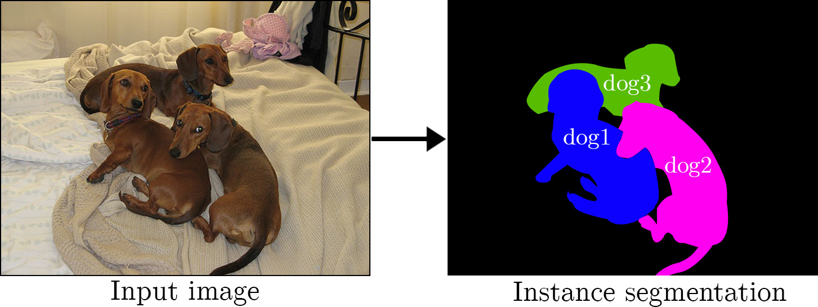
Instance segmentation
Instance segmentation is identifying each different object instance of the same class or category within an image.
Notes:
For example. The dogs in the input image are distinguished into three distinct dogs.

Slide 13
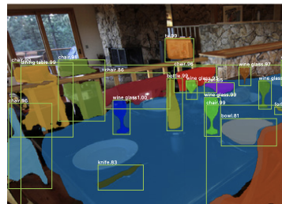
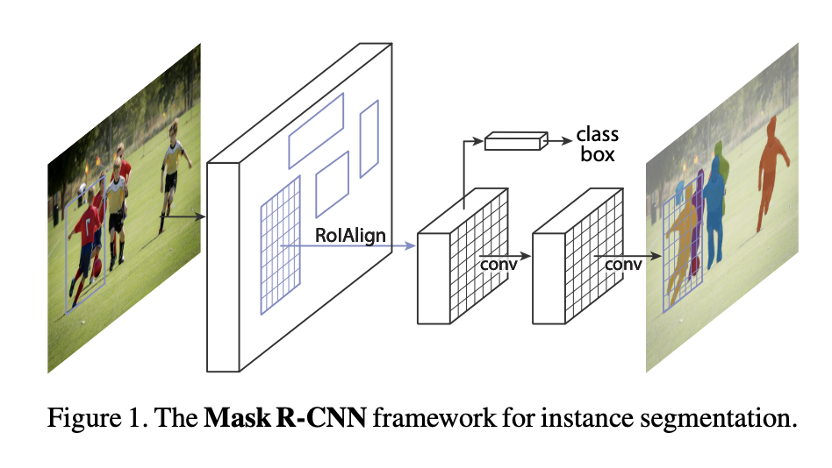
Mask RCNN
Facebook AI research group present Mask R-CNN model. It is a state-of-art method in the image instance segmentation. The segmentation is in parallel with the identification and localization tasks.
Notes:
MaskR-CNN, a state-of-the-art method in the image instance segmentation. The segmentation is in parallel with the identification and localization tasks.

Slide 14
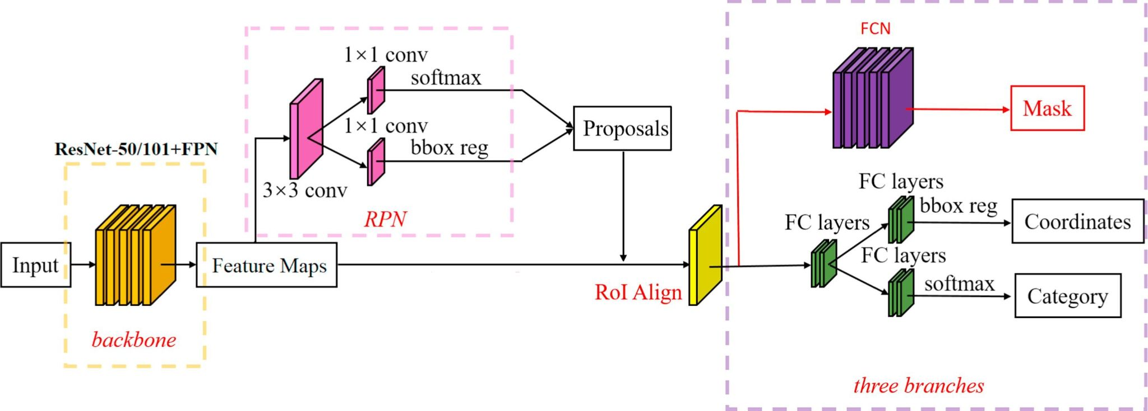
Mask RCNN Framework (3 stages)
The backbone network extracted feature maps from input images.
Feature maps were sent to the region proposal network (RPN) to generate regions of interest(ROIs).
ROIs were mapped to extract the corresponding target features in the shared feature maps, then it output to the fully connected (FC) layer for classification, and output to the fully convolutional network (FCN) for instance segmentation.
Notes:
This process generated the classification scores, bounding boxes and segmentation masks.

Slide 15
Experiment Detail

Slide 16
Model 1: Cascaded

Slide 17
Mask RCNN
Use this model to detect openings and building instance
Dataset: (annotate the building and openings)
Train set：87 images
Val set：18 images
Do the fine-tuning of Mask R-CNN with pretrained Cityscapes weights.
Train set: annotate ‘building’ and ‘opening’

Slide 18
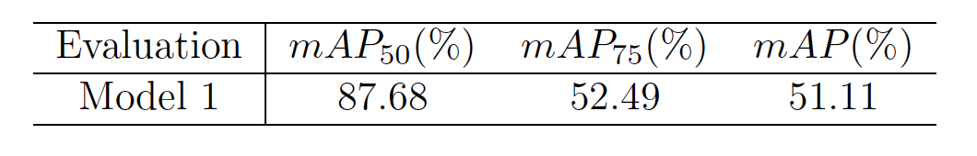
Evaluation
Mean average precision (mAP): mAP is finding the area under the precision-recall curve at certain IoU(intersection over union) threshold.
When mAP₅₀ >70%, we consider this model’s performance is good

Slide 19
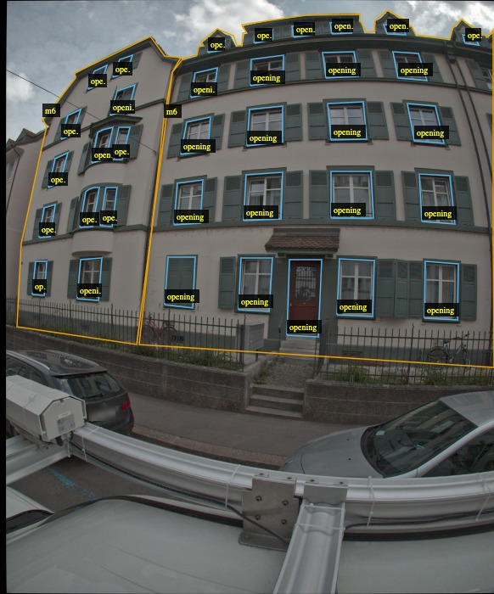
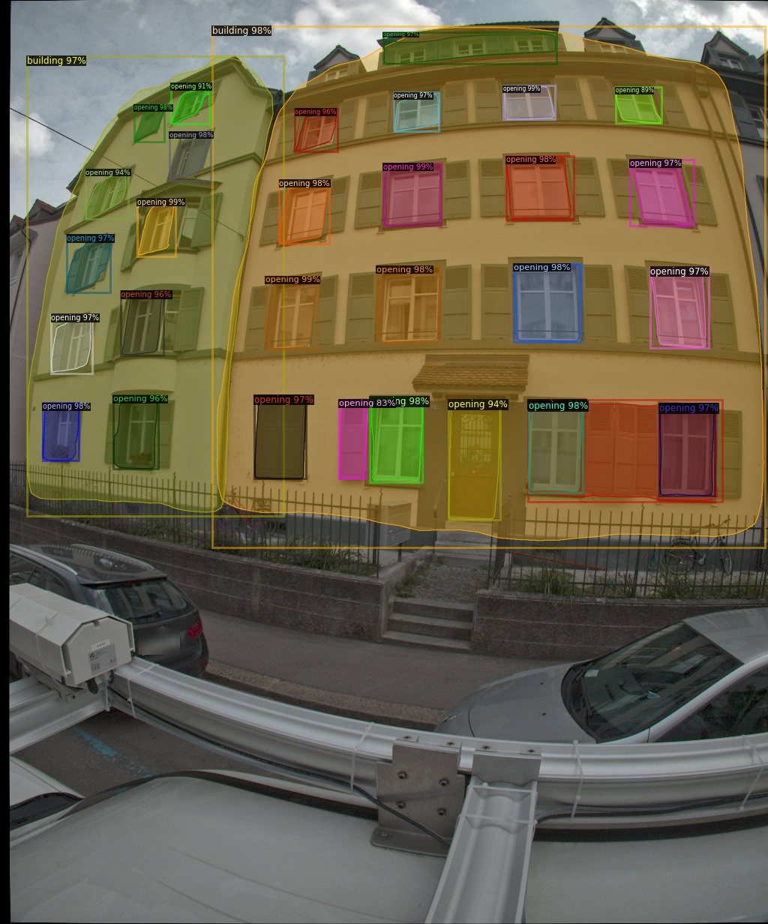
Validation of prediction
The model predict the bounding box and boundary mask of opening, and building
The windows, doors, and roof of buildings are nicely predicted
Input image
Predicted image

Slide 20
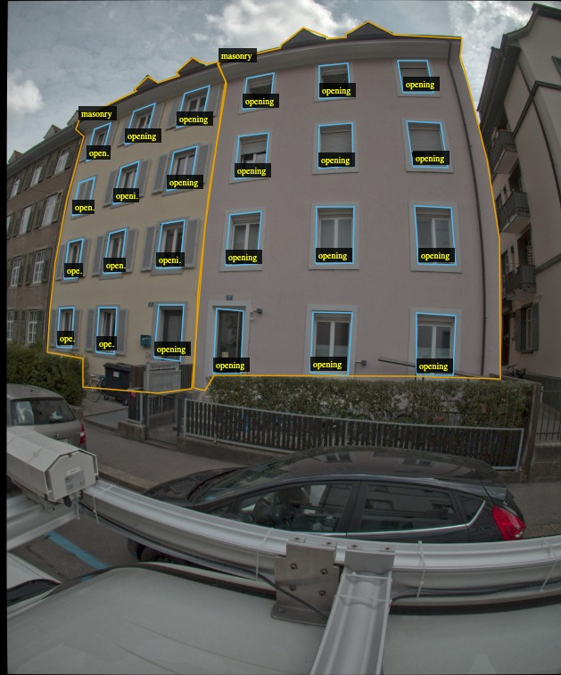
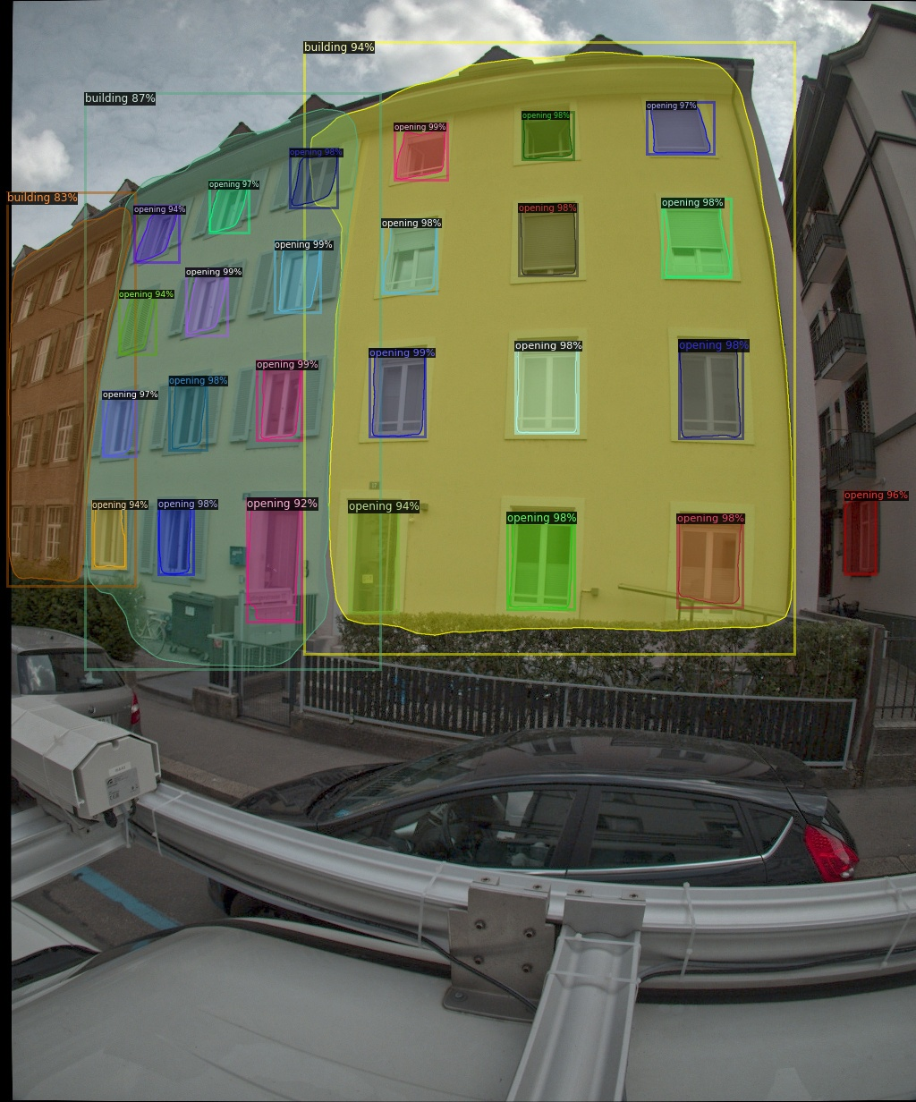
Validation of prediction
Another example
Input image
Predicted image

Slide 21
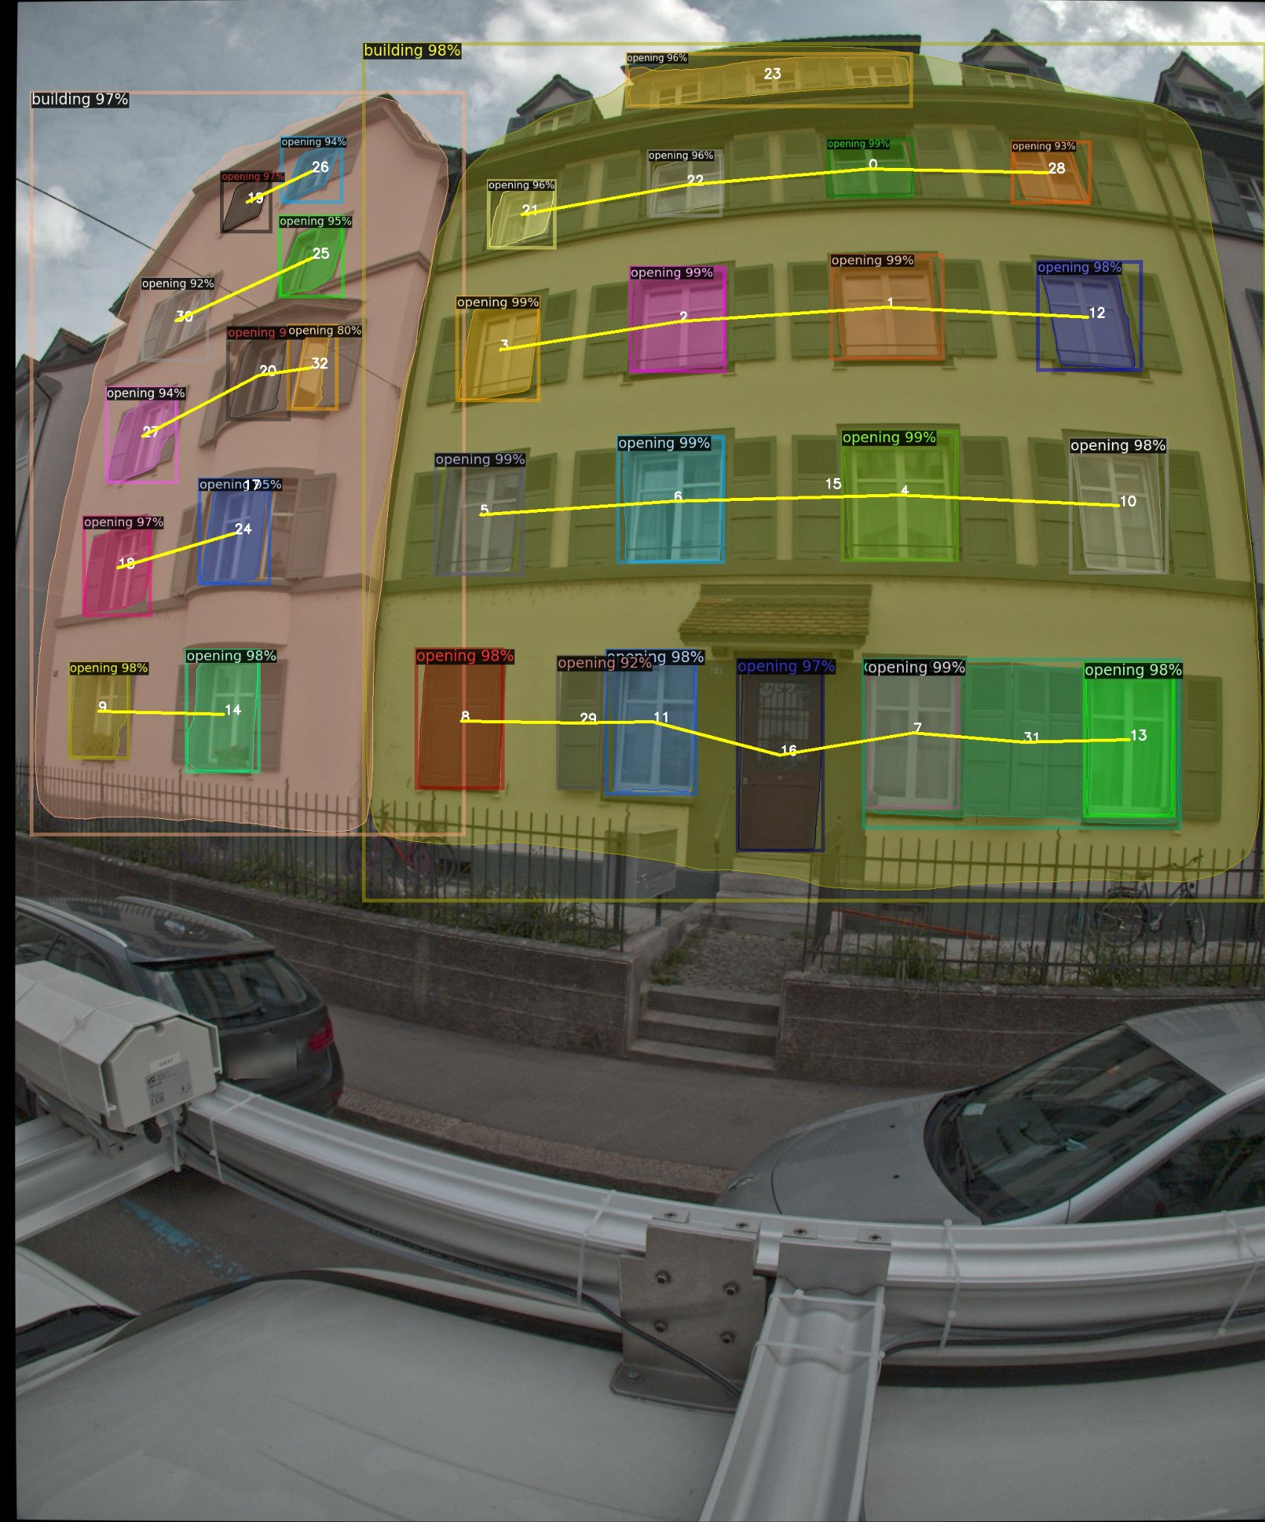
Estimate Building floor
By connecting the centroid of openings, we can draw the building floor line
To find the floor level, we set the slope angle of building roof as the baseline angle A, then connect the openings’ centroid within a range of angle [A-θ, A+θ]
θ
Roof slope angle A
θ
a
b

Slide 22
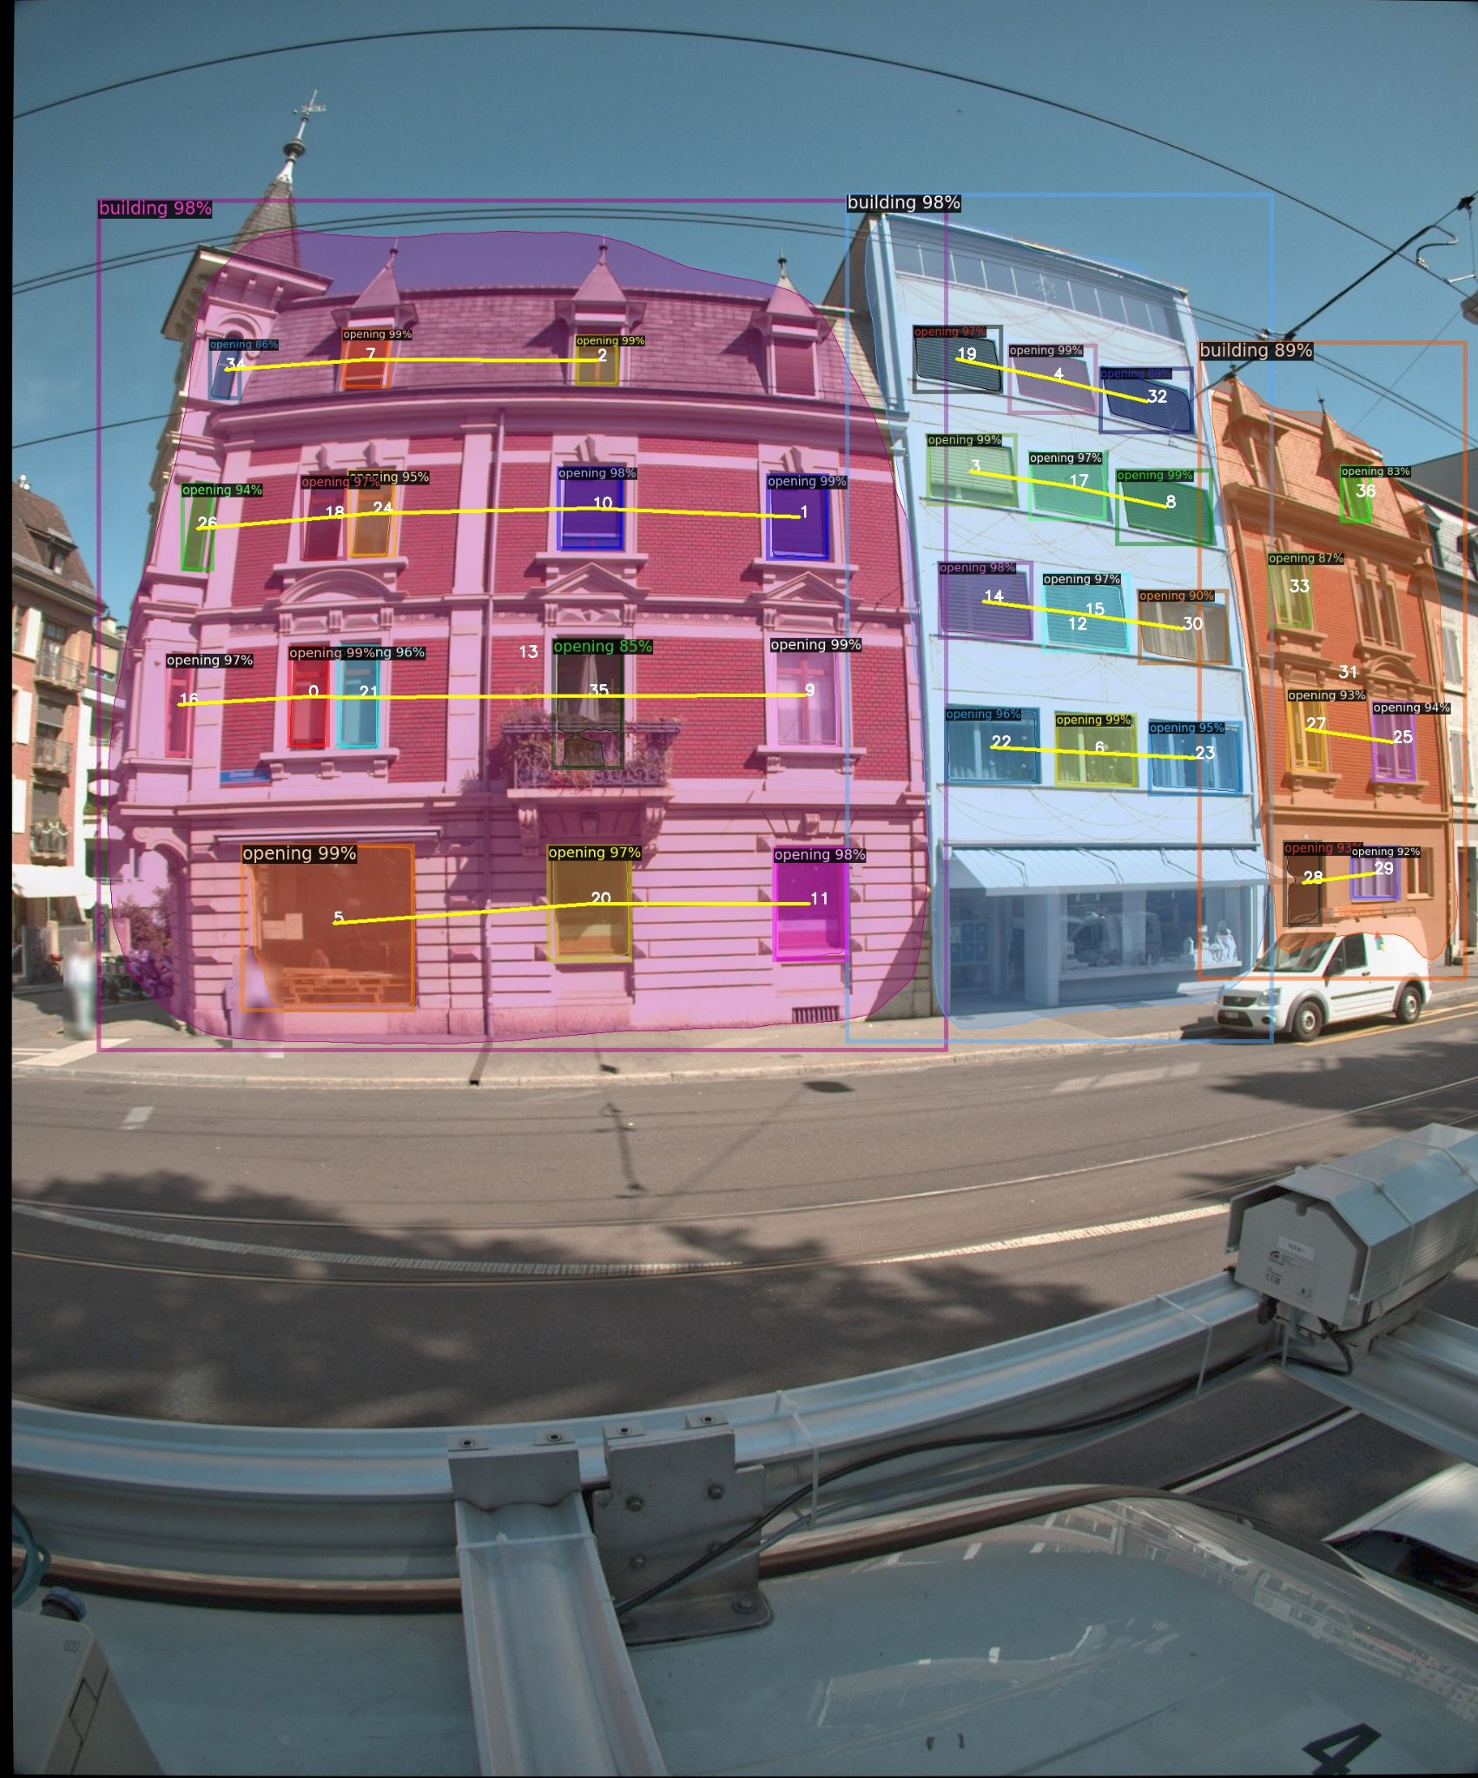
Difference in the floor height of adjacent buildings
Calculate the centroid coordinates of each floor lines in two adjacent buildings Centroid coordinates for two building Building A : [a1,a2,a3,a4] Building B : [b1,b2,b3,b4]
Then find the difference of centroid y-axis to get the difference in the floor height of adjacent buildings
A
B
a2
b1

Slide 23
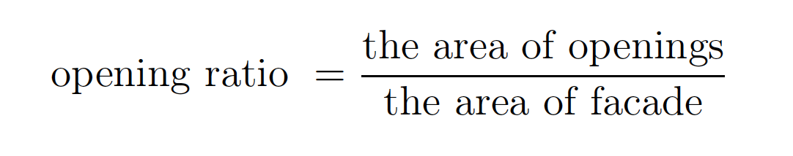
Detect building type
Different types of buildings usually have different opening ratios. We try to determine the building type by setting the threshold of the opening ratio
Calculated the opening ratio of the annotated building in the train set (87 images)
Result: Because of the limitation of dataset, we can not find the clear threshold of opening ratio to differ the building type

Slide 24
Model 2: Multi-task

Slide 25
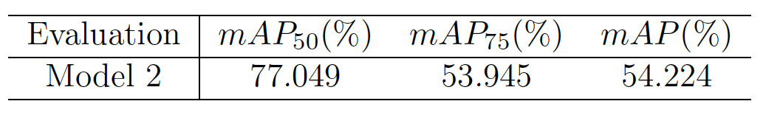
Model 2
Use this model to predict building instance and building type
Dataset:(annotate the building type)
Train: 449 images
Val: 96 images
Do the fine-tuning of Mask R-CNN with pretrained Cityscapes weights on our own building image datasets
Evaluation: mean average precision (mAP)
Train set: annotate ‘Masonry’, or ‘M6’ or ‘RCW’

Slide 26
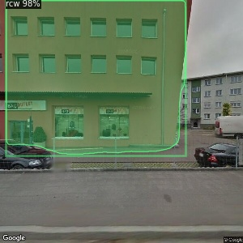
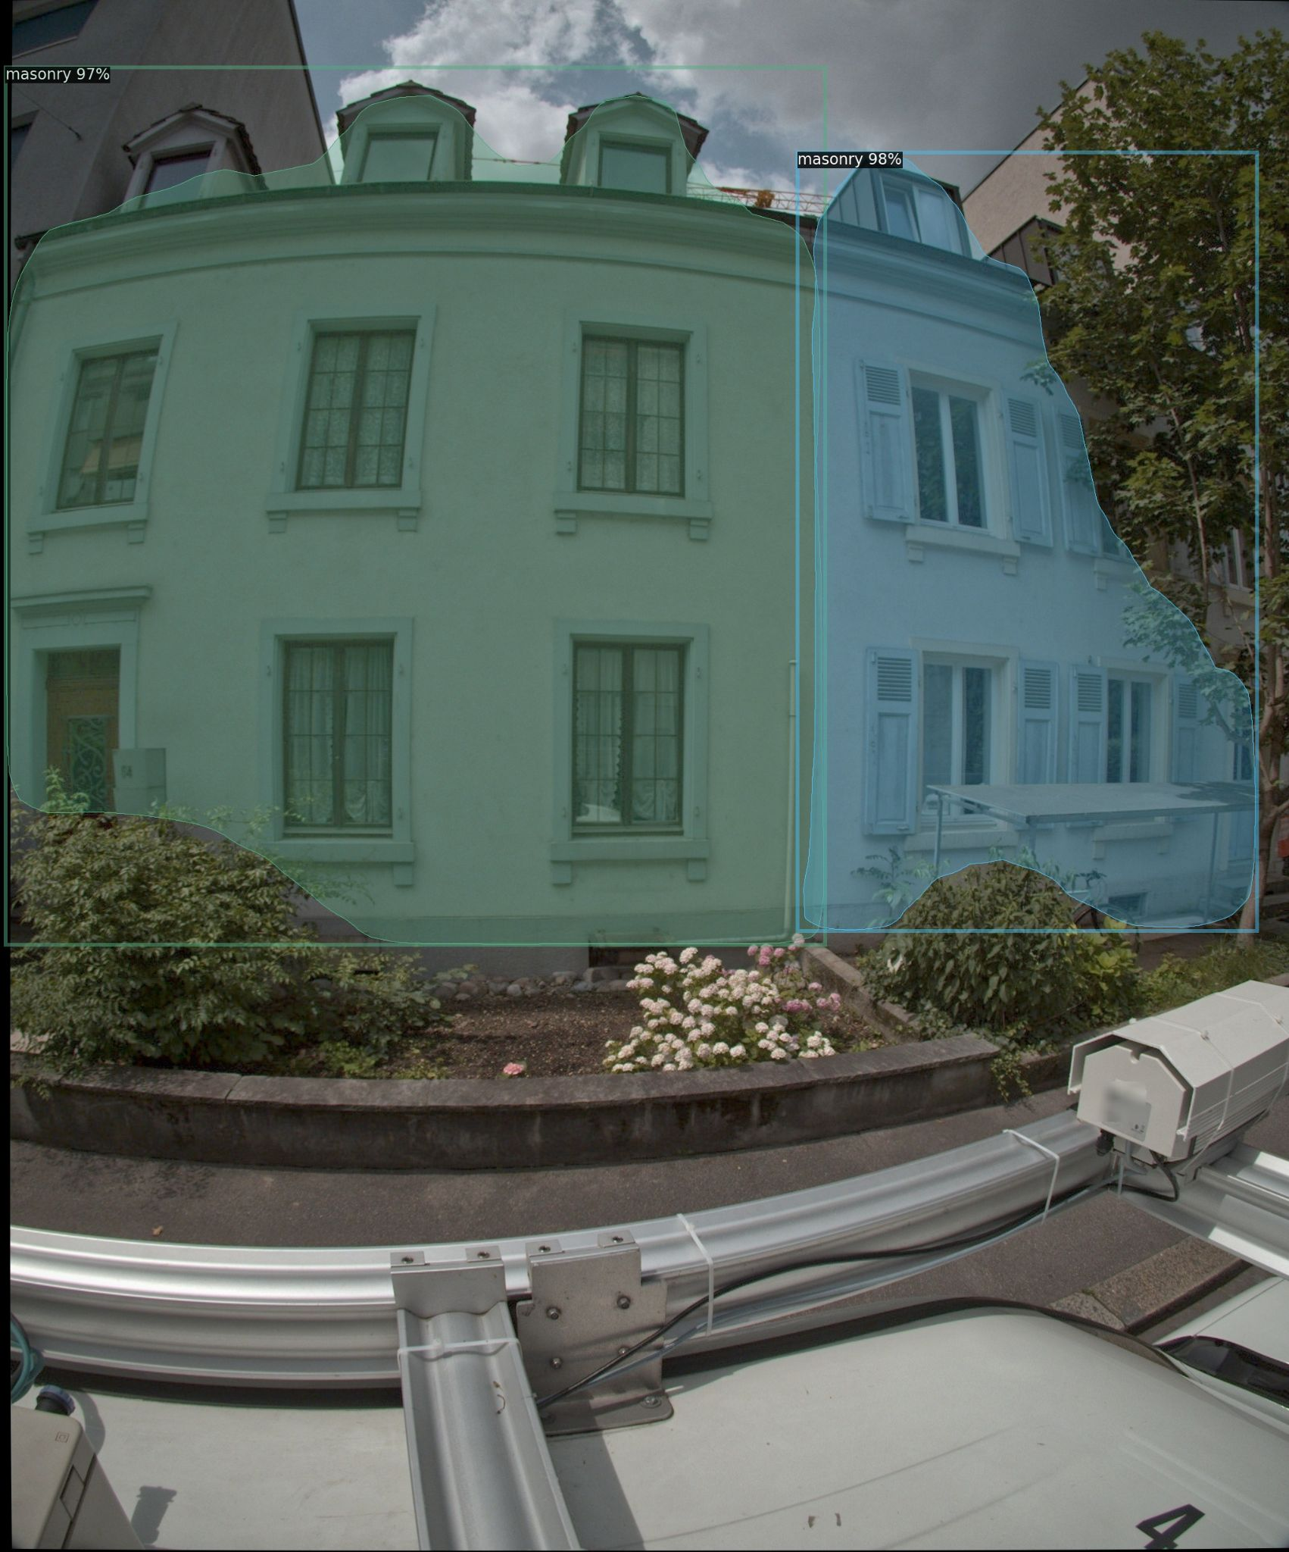
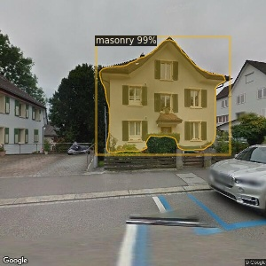
Validation of prediction
The building type and the boundary of building are clearly shown on the prediction

Slide 27
Duplication Detection

Slide 28
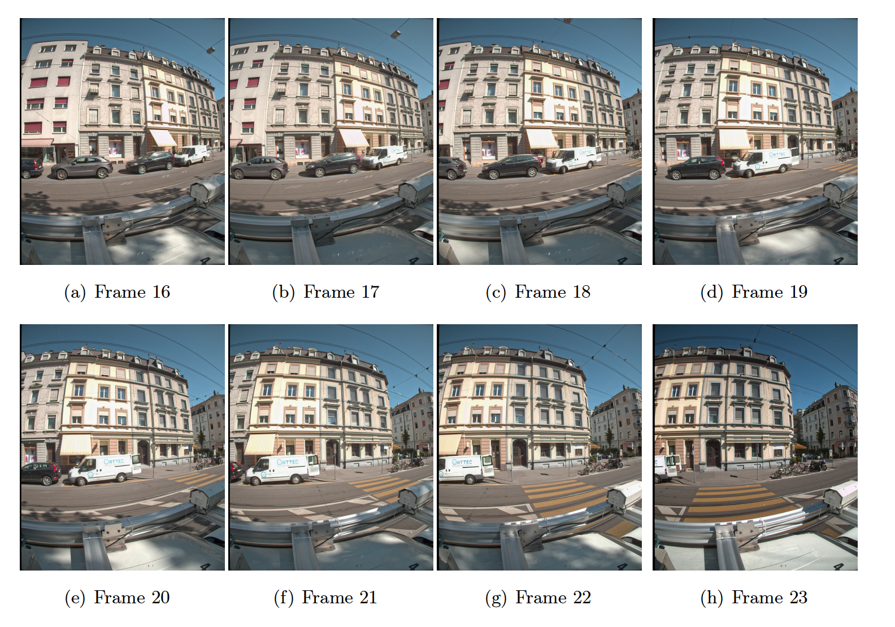
Duplicated buildings
One building appears in the several images. After using model 1 finding the building instance, it will generate duplicated buildings.
In order to count the building number, duplication should be clustered

Slide 29
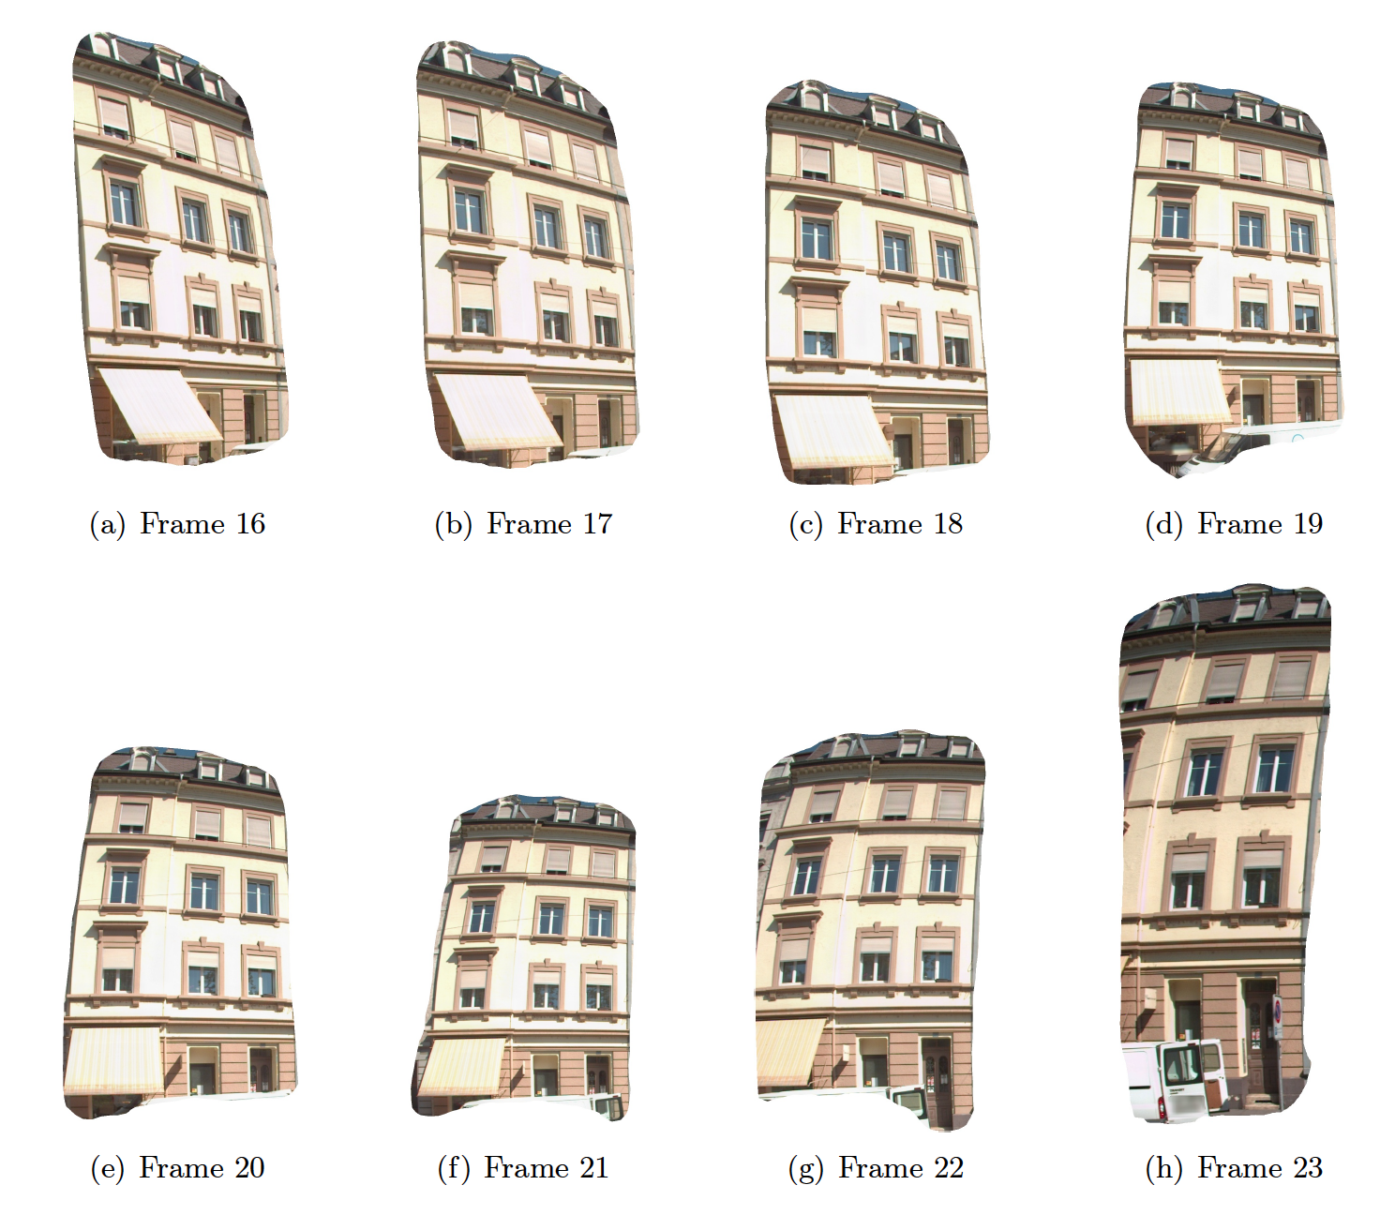
8 building duplications are the same building
The clustering is different from image retrieval work in which they just care about the top 5 close images but here we need to exactly find all the duplications.

Slide 30
Methods of duplication detection
Image-based Keypoint Matching and Clustering
Use local descriptor and keypoint matching to get the number of matched keypoints. Based on this number, do the image clustering
Global World Coordinate
Convert building centroid coordinates in the images to global coordinates, then check if buildings’ global coordinates are close

Slide 31
Keypoint Matching and Clustering
After model 1 prediction, we get the cropped building instances
We do the keypoint matching and clustering on the cropped building instance image
Input image
Building instances after model 1 prediction

Slide 32
Image clustering
Image clustering methods are usually based on the distance matrix of data point
How can we get the distance?
First get the number of matched keypoint of two building instance
Then consider the reciprocal of it as the distance
Notes:
In this diagram, minPts = 4. Point A and the other red points are core points, because the area surrounding these points in an ε radius contain at least 4 points (including the point itself). Because they are all reachable from one another, they form a single cluster. Points B and C are not core points, but are reachable from A (via other core points) and thus belong to the cluster as well. Point N is a noise point that is neither a core point nor directly-reachable.

Slide 33
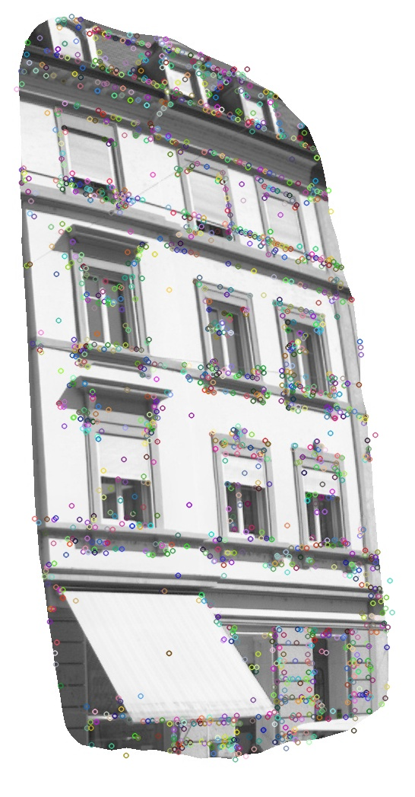
keypoint feature and local descriptors
Local keypoint feature and descriptors are invariant to image illumination, scaling and rotation.
Feature descriptors encode interesting information of keypoint neighborhoods into a series of numbers.
It act as a sort of numerical "fingerprint" that can be used to differentiate one feature from another. Ideally this information would be invariant under image transformation.
Use DoG-Affnet* Model to extract the feature and descriptors
* Dmytro Mishkin, Filip Radenovic, and Jiri Matas. Learning discriminative affine regions via discriminability. CoRR, abs/1711.06704, 2017
Feature Keypoints
Notes:
AffNet is a novel method for learning local affine-covariant regions. The affine shape estimator outperforms the state-of-the-art in image retrieval
Affine-covariance is a desirable property of local features since it allows robust matching of images separated by a wide baseline, unlike scale-covariant features like ORB that rely on tests carried out on circular neighborhoods. Affine-covariance is on ellipse neighborhoods
Here is the information about the local neighbourhood image gradients the numbers of the feature vector.

Slide 34
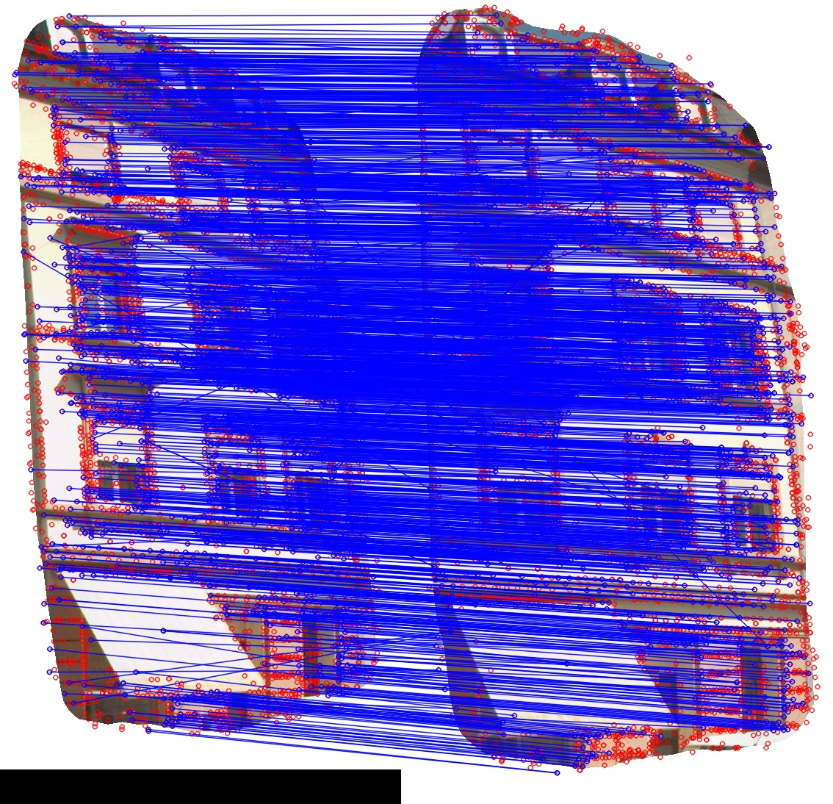
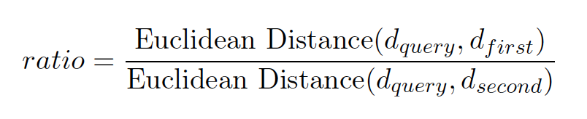
Keypoint Matching
Image 1
Image 2
According to the Lowe’s ratio test, do the feature keypoint matching. d_{query}: one feature descriptor in the image 1 d_{first} : the descriptor in the image 2 having the closest distance with d_{query}
d_{second} : the descriptor in the image 2 having the second closest distance with d_{query}
If ratio < 0.8, we recognize d_{query}, d_{first} related keypoints are matched keypoints
Keypoint matching between two building instances

Slide 35
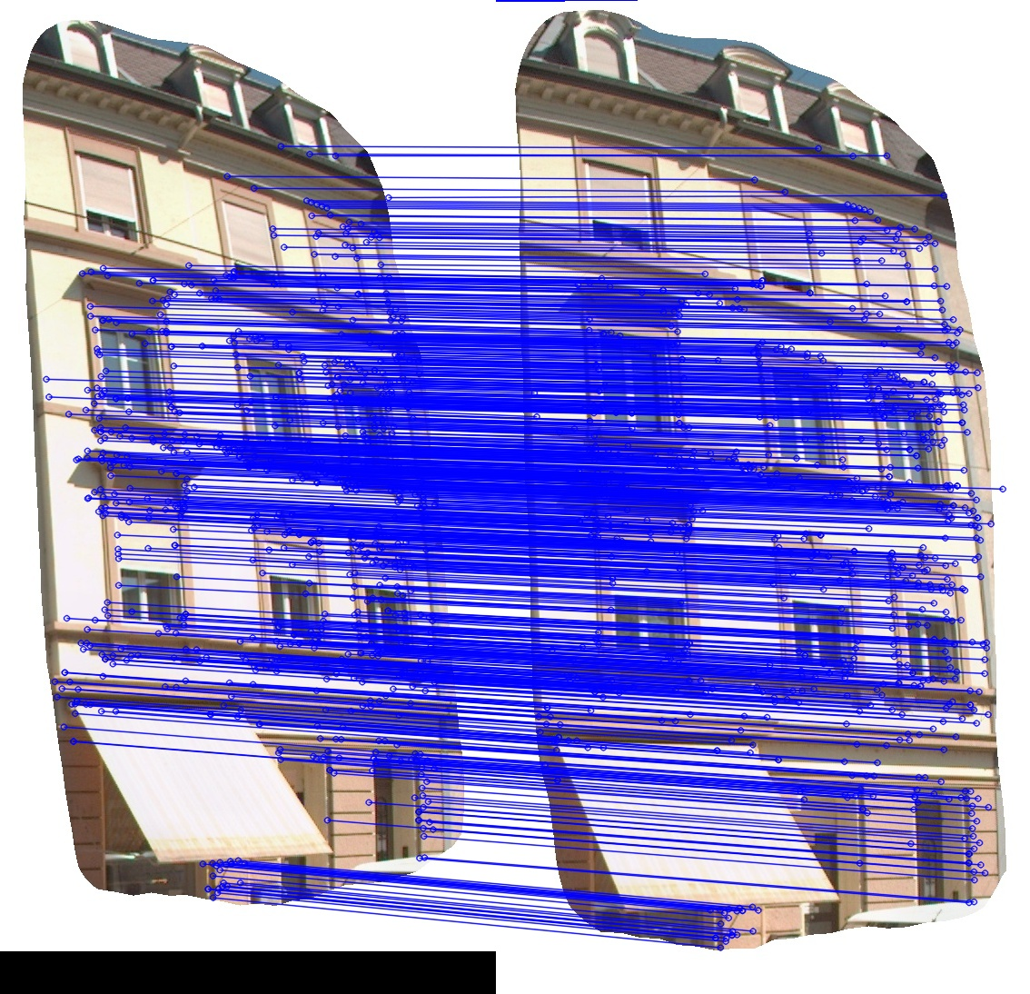
Matching correction by RANSAC
Use RANSAC to decrease the number of incorrectly matched feature points
Random sampling consensus is an iterative method of estimating mathematical model parameters by using observed data points.
Matching before RANSAC
Matching After RANSAC
Notes:
The data points include inlier and outlier.

Slide 36
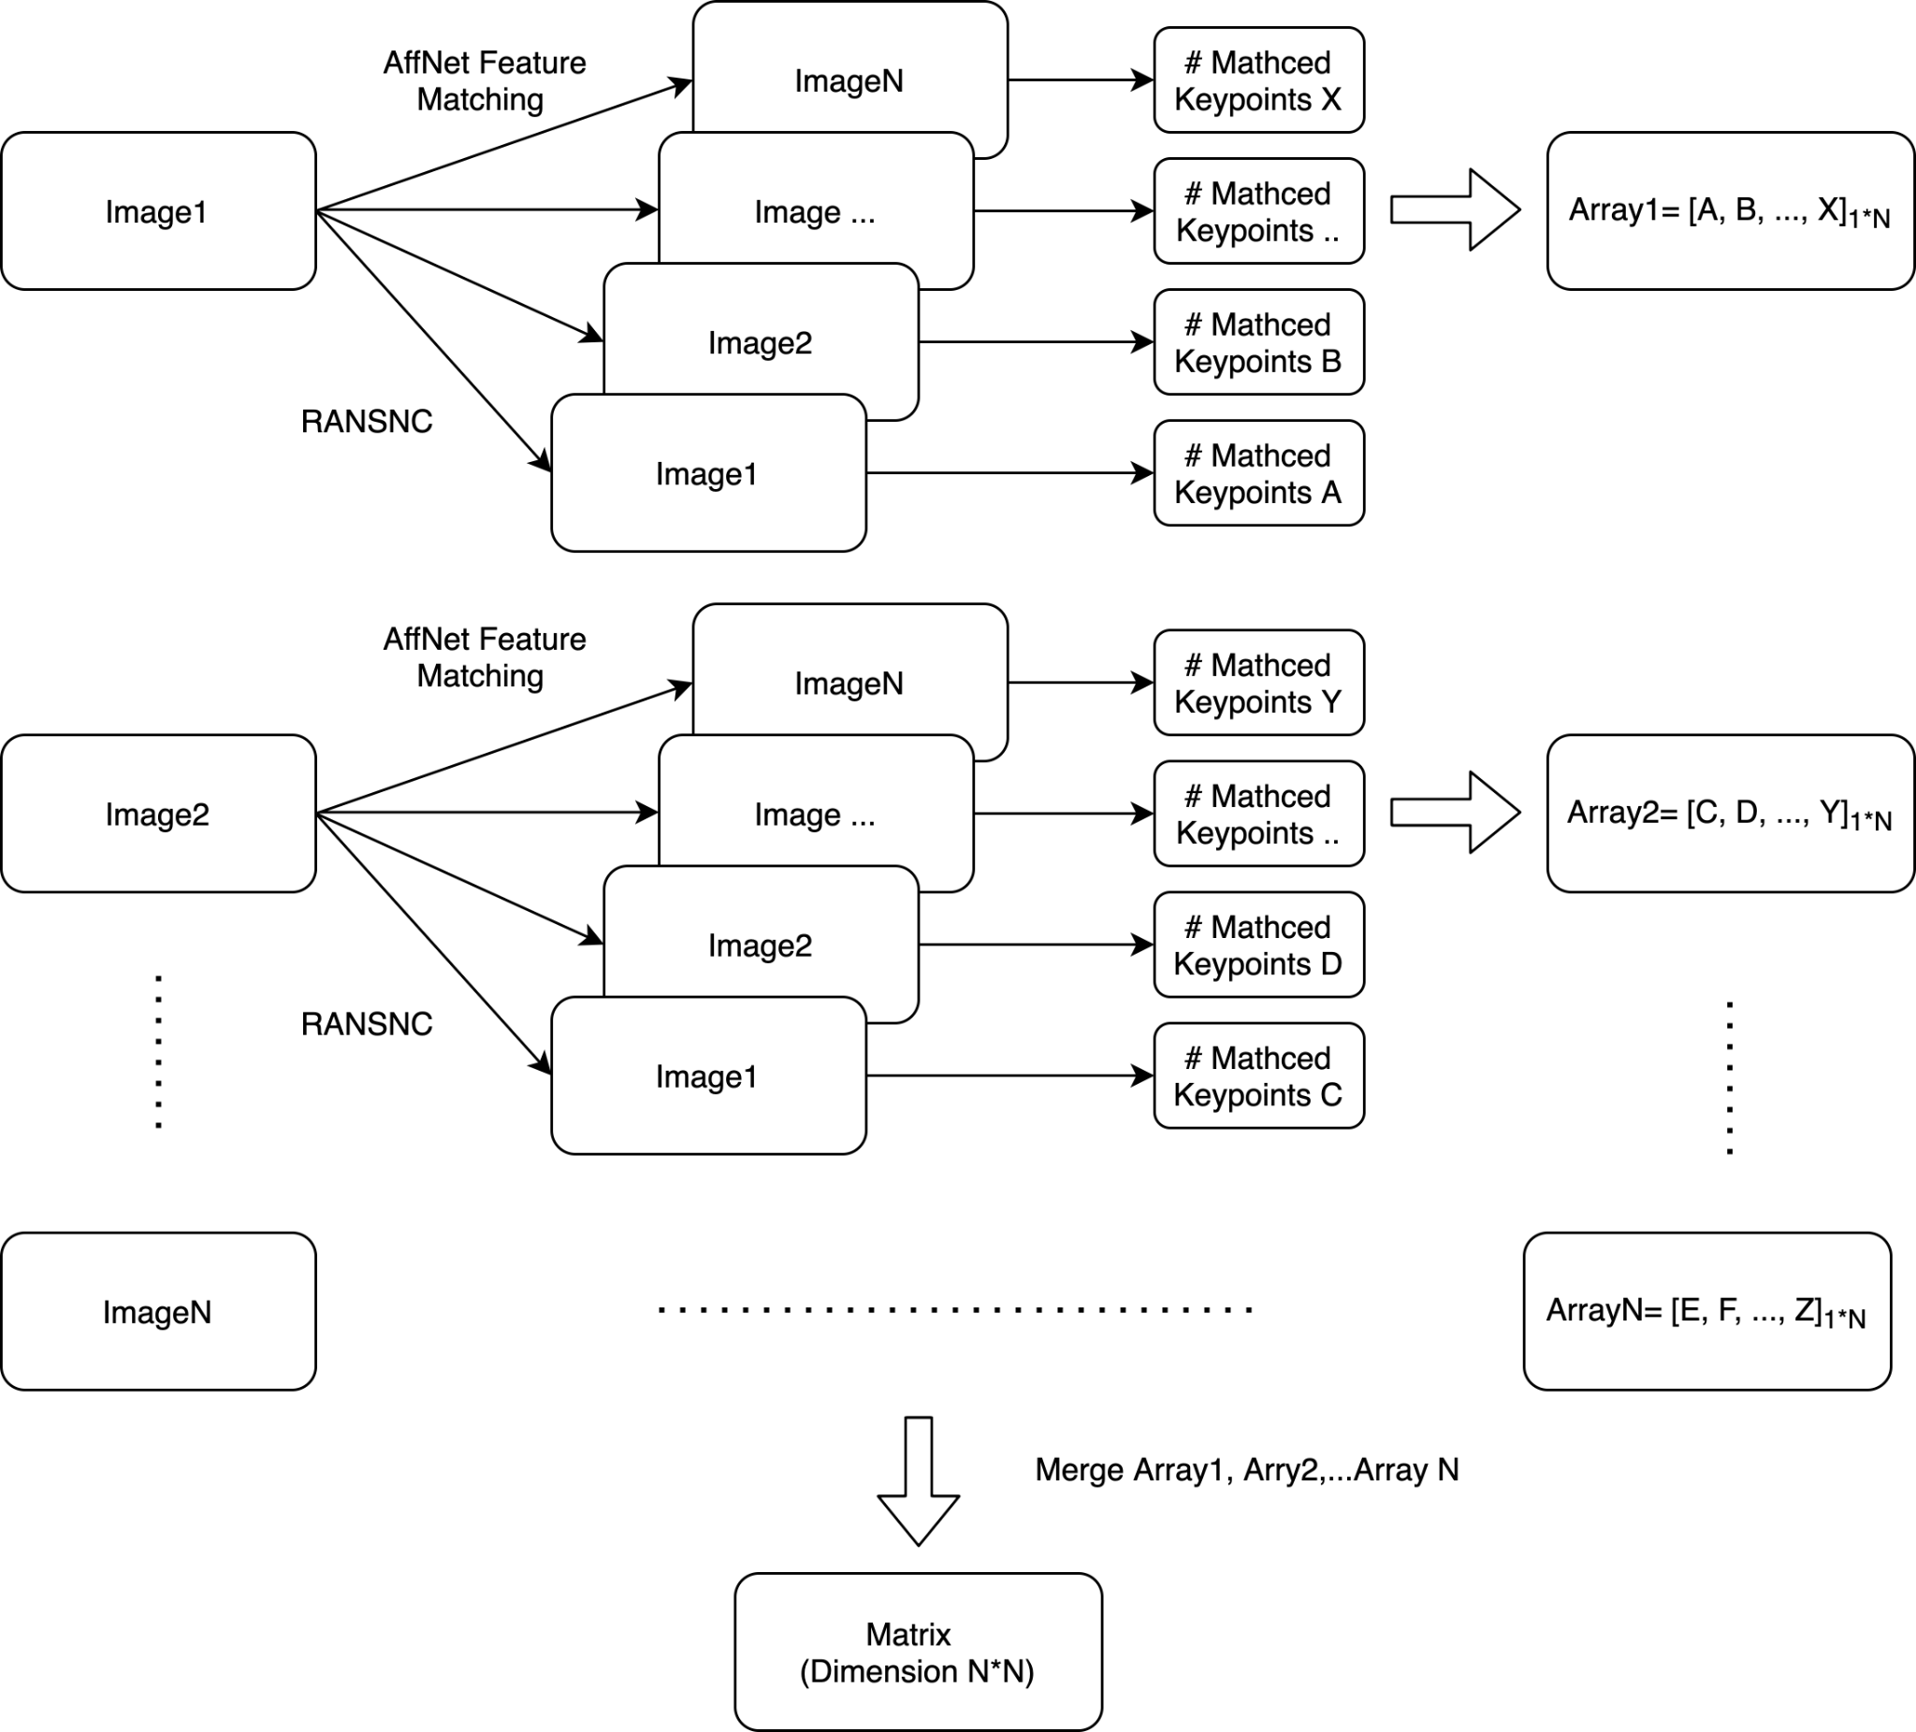
Matching matrix
Calculated the number of matched keypoints between every two building instance, and record the value as matching matrix
If we have N building instance, the matrix dimension is N*N

Slide 37
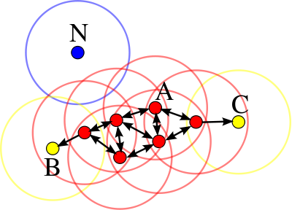
Image clustering - DBSCAN
DBSCAN stands for Density-based spatial clustering of applications with noise. This algorithm can identify clusters in large spatial data sets by looking at the local density of based database elements, based on the distance between observed data
DBSCAN do not need to predefined the number of clusters
min_samples =4
Notes:
In this diagram, minPts = 4. Point A and the other red points are core points, because the area surrounding these points in an ε radius contain at least 4 points (including the point itself). Because they are all reachable from one another, they form a single cluster. Points B and C are not core points, but are reachable from A (via other core points) and thus belong to the cluster as well. Point N is a noise point that is neither a core point nor directly-reachable.

Slide 38
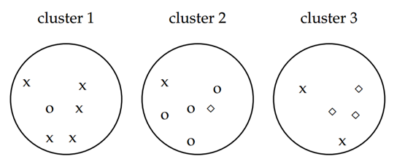
Evaluation: Purity
Purity: The number of correctly clustered samples divided by the total number of samples.
Here, purity = (5 + 4 + 3) / (6 + 6 + 5) ≈ 0.71

Slide 39
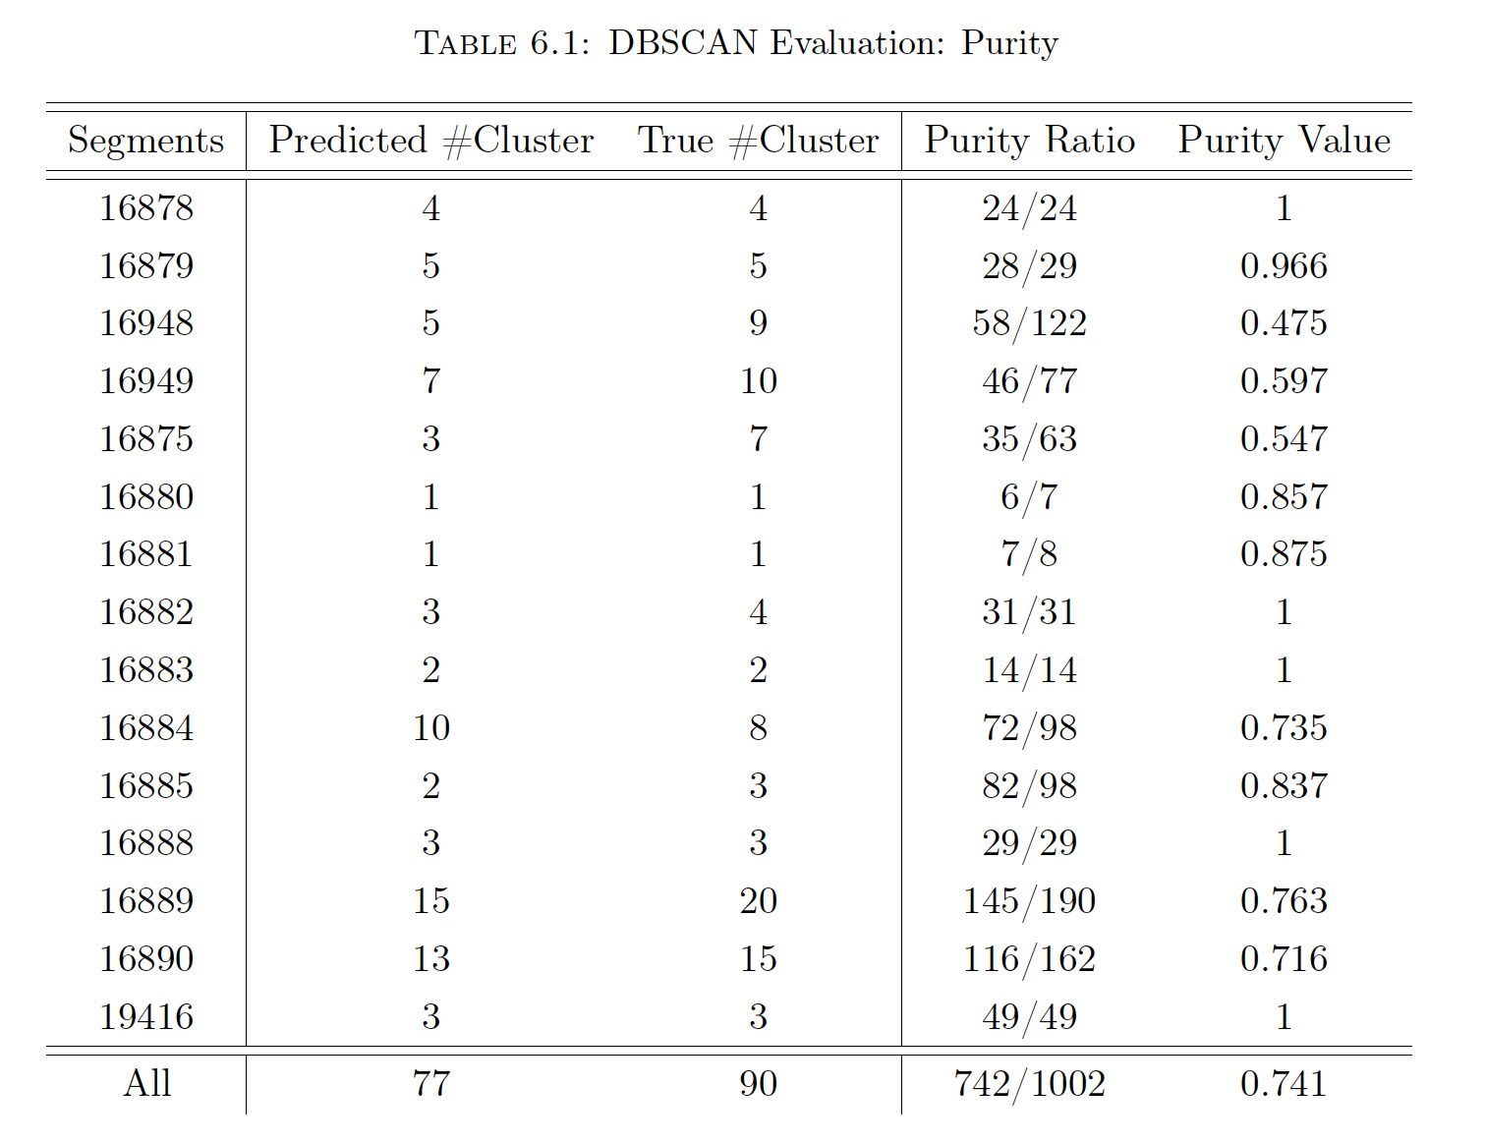
Evaluation: Purity
For each segment, we run the DBSCAN clustering and get the purity.
The overall purity is 0.741 in our project

Slide 40
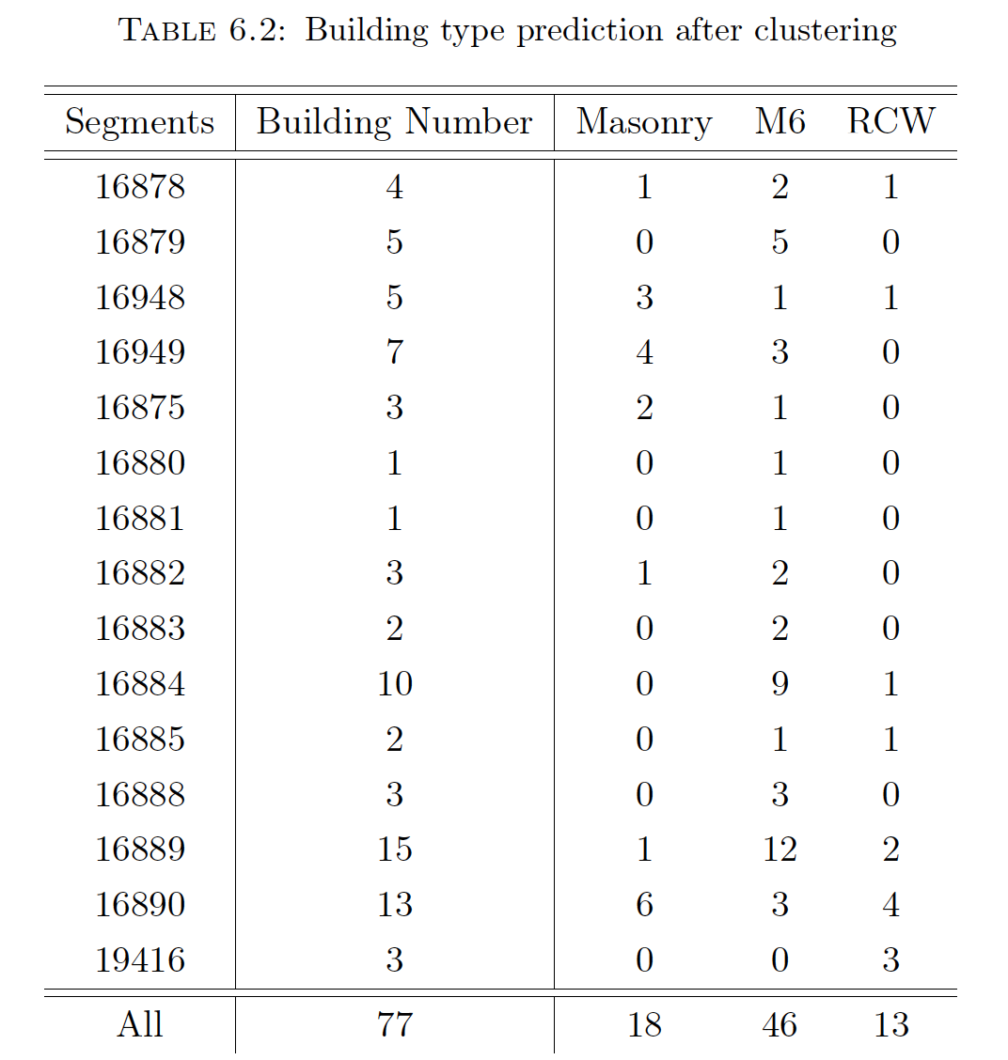
Building type ratio
After clustering, we combine the model 2’s result to get the building type
In the 15 testing segments from the Basel area, there are 77 buildings (18 Masonry, 46 M6, 13 RCW) located in this area.
Building type ratios for Masonry, M6, and RCW are 23.4%, 59.7%, 16.9%.
Notes:
Segments of street

Slide 41
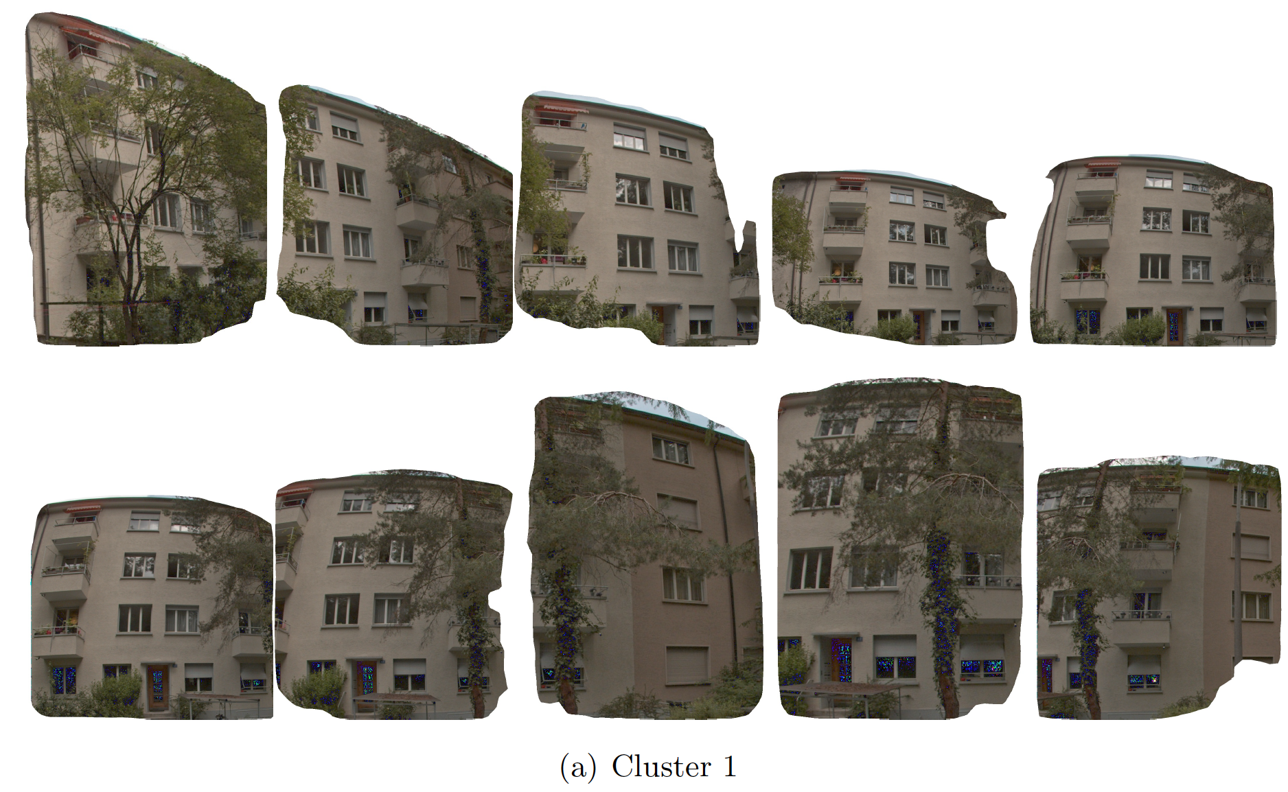
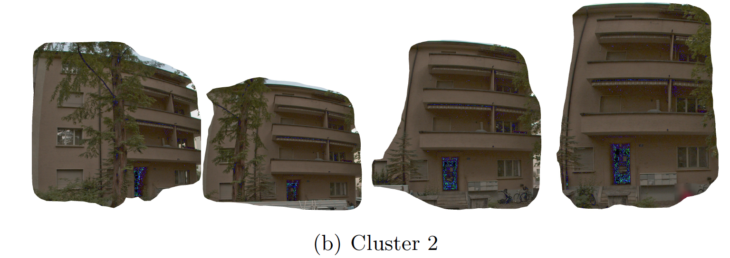
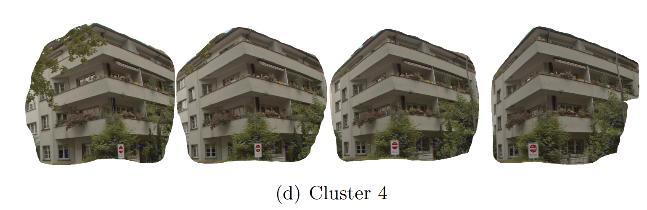
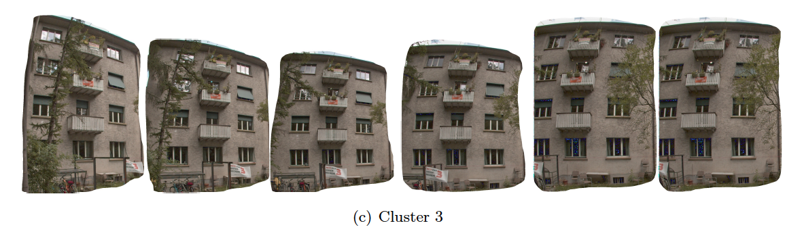
M6
Masonry
RCW
Result: Clustered buildings from same segment
M6

Slide 42
Conclusion and Future work

Slide 43
Conclusion
Successfully use mask rcnn model to detect the building instance and opening. Also, we estimate the number of floor and the difference in floor height of adjacent buildings.
Predict the building type by mask rcnn model
Use feature keypoint matching and DBSCAN clustering method to tackle the duplication problem, then count the building number after clustering

Slide 44
Future work
Handle the problems of converting the image coordinate to the global world coordinate, then show the building type on the map.
Expand the training set (annotate more) of model 1 to find the threshold of opening to facade ratio;
Add more building types (annotate more) to be predicted in model 2.
Use 3D Lidar point cloud data to do the instance segmentation and object classification.

Slide 45
Thank you

Slide 46
Appendix

Slide 47
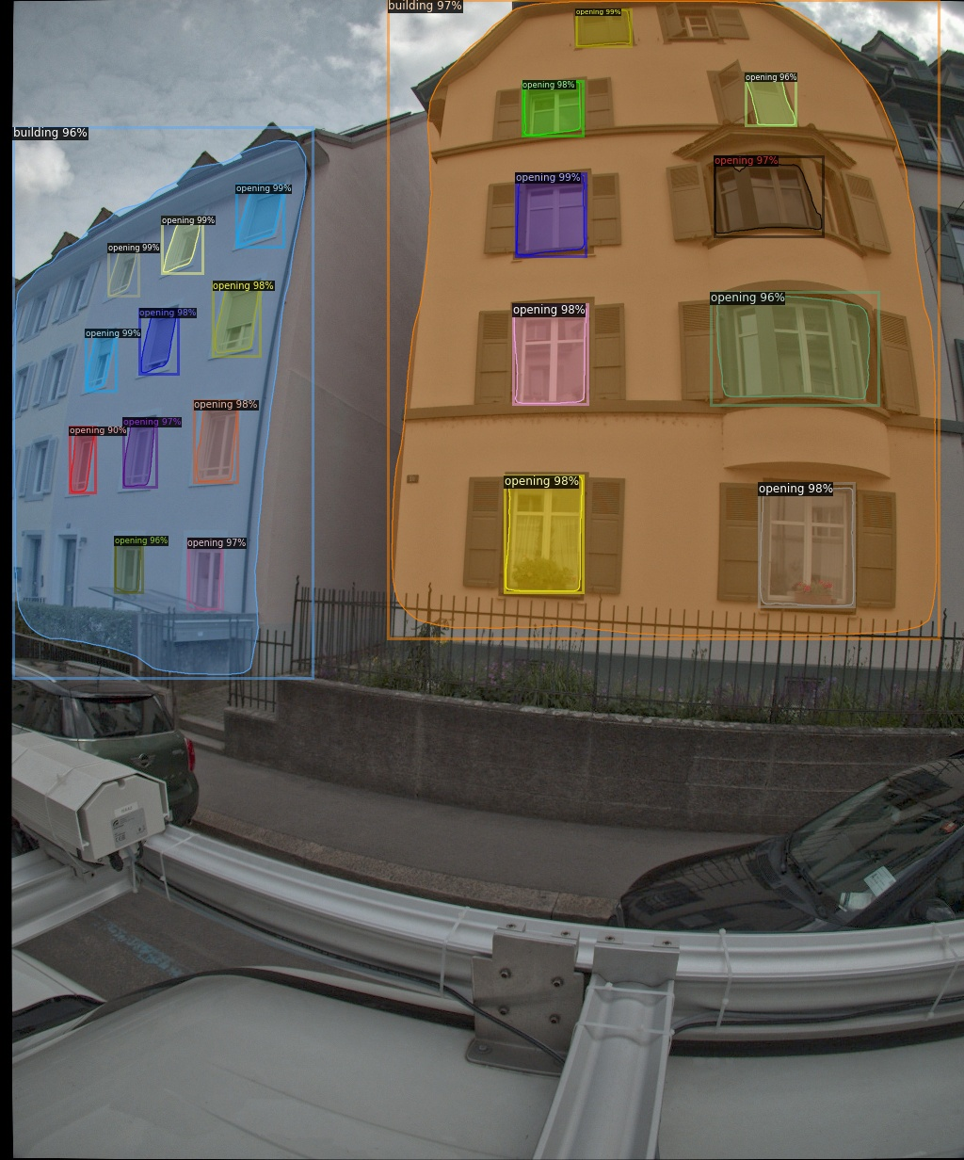

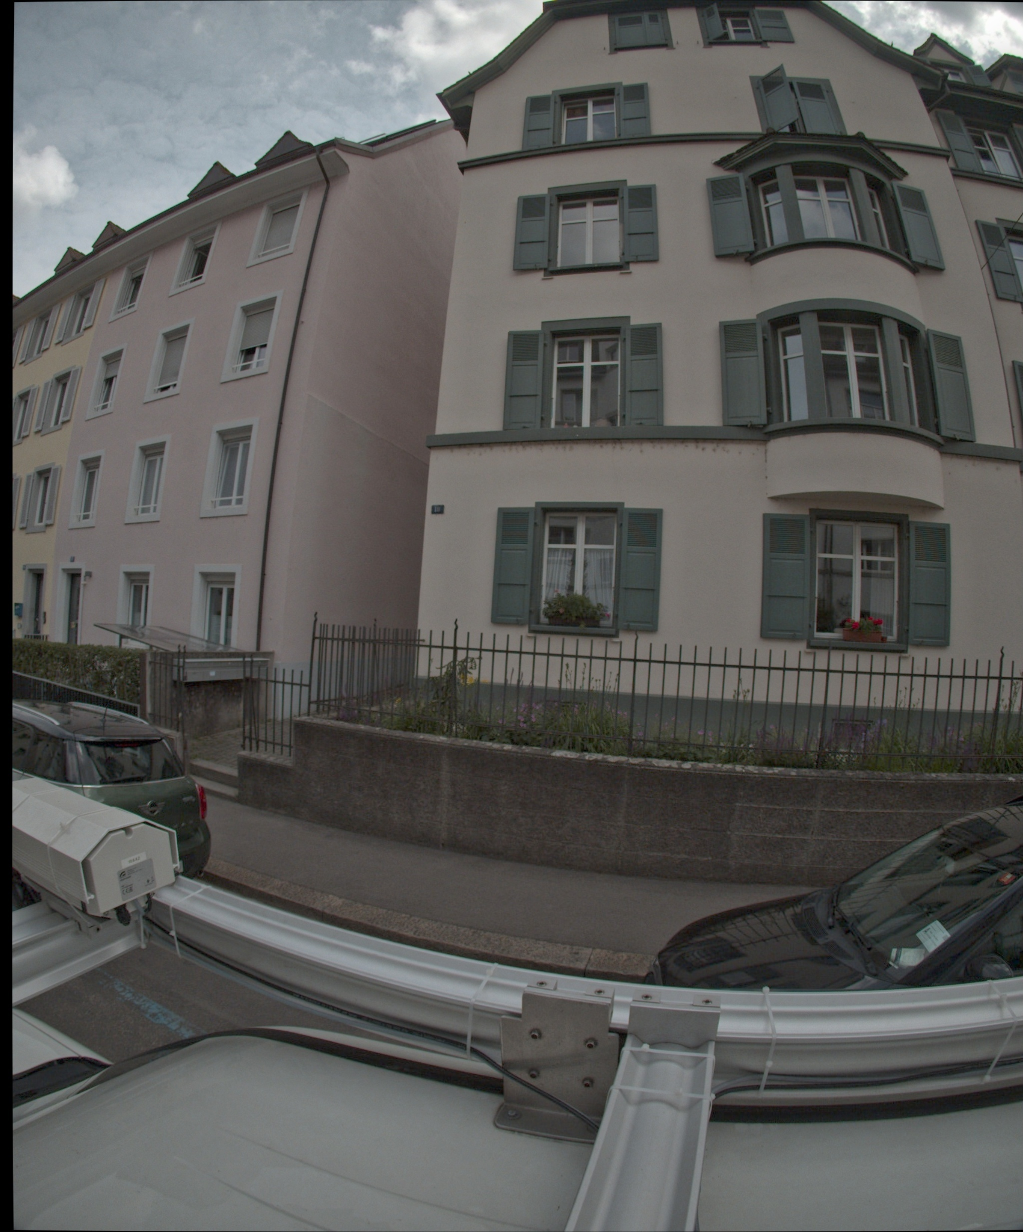
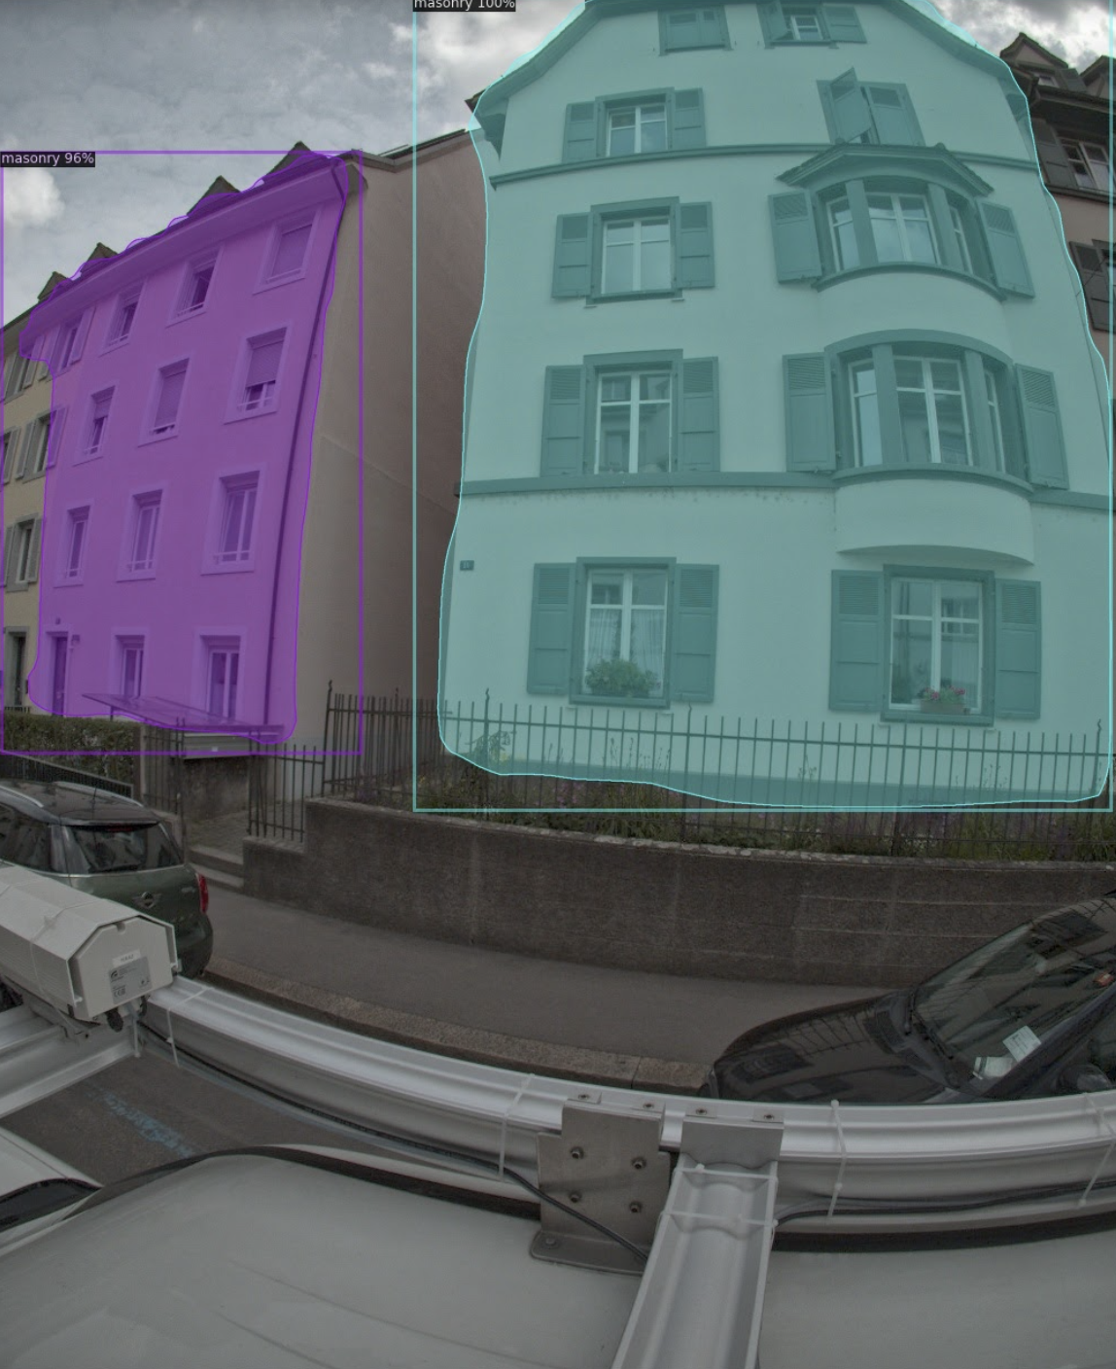
Combine building type
Building Instance
Model1
Connection: Check if centroid coordinates
(two red point) are close
Building Instance
and Building Type
Model2
Building Type

Slide 48
Fine tuning
it can help to avoid over-fitting and make the model more robust.
Usually, we fine-tune some higher-level portions of the network. The reason is that the pre-trained model’s earlier layers contain more generic and fundamental features that could be useful to many tasks, but later or deeper layers become more specific to the details of the classes contained in the original dataset.
In our Fine-Tunned Mask RCNN model, we
Use the pre-trained ResNet model training on the CityScapes dataset; The Cityscapes dataset focuses on semantic understanding of urban street scenes. Cityscapes dataset is similar to our dataset since it contains many buildings
2. Keep the parameter of the backbone ResNet, and fine tune the RPN, classifier, and mask heads of the network.

Slide 49
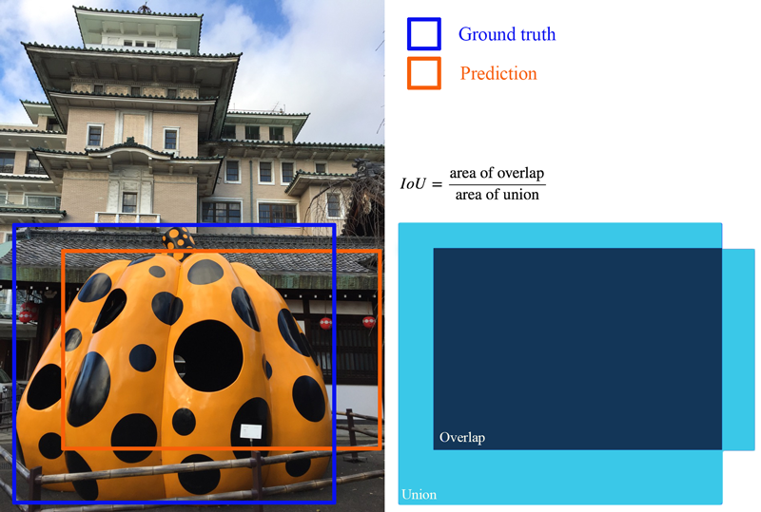
Evaluation
For object detection tasks, we calculate precision and recall using IoU value for a given IoU threshold.
Precision: It measures how many of the predictions that model made were actually correct.
Recall measures how good you find all the positives
For each bounding box, we measure an overlap between the predicted bounding box and the ground truth bounding box. This is measured by IoU (intersection over union)
Notes:
Object detection systems make predictions in terms of a bounding box and a class label.

Slide 50
Evaluation
We set IoU threshold as 0.5, and the IoU value for a prediction is larger than 0.5, then we classify the prediction as True Positive (TF).
Mean average precision (mAP): mAP is finding the area under the precision-recall curve at IoU threshold.
When mAP₅₀ >70%, we consider this model’s performance is good

Slide 51
Image clustering - DBSCAN
DBSCAN stands for Density-based spatial clustering of applications with noise. This algorithm can identify clusters in large spatial data sets by looking at the local density of based database elements, based on the distance between observed data
DBSCAN do not need to predefined the number of clusters
There are two key parameters
eps: searching radius
min_samples: minimum number of points required to form a dense region
min_samples =4
Notes:
In this diagram, minPts = 4. Point A and the other red points are core points, because the area surrounding these points in an ε radius contain at least 4 points (including the point itself). Because they are all reachable from one another, they form a single cluster. Points B and C are not core points, but are reachable from A (via other core points) and thus belong to the cluster as well. Point N is a noise point that is neither a core point nor directly-reachable.

Slide 52
Set min_sample as 4. After having a deep digging into the cropped building images, we found one single image usually has more than 4 duplications (include itself). we ignore the building if its duplication number is smaller than 4.
Set eps in range (0.2,0.6,0.02). Loop the DANSCAN method in this range to find the eps that make the predicted clusters having maximum cluster numbers. At the same time, we keep the size of the noise group (in the code, noted as group ’-1’)as small as possible.

Slide 53
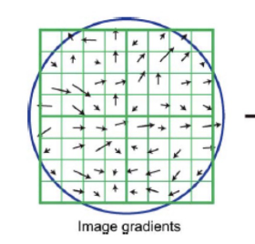

DoG-Affnet
AffNet is a novel method for learning local affine-covariant regions. The affine shape estimator outperforms the state-of-the-art in image retrieval
Affine-covariance is a desirable property of local features since it allows robust matching of images separated by a wide baseline, unlike scale-covariant features like ORB that rely on tests carried out on circular neighborhoods. Affine-covariance is on ellipse neighborhoods
Notes:
Here is the information about the local neighbourhood image gradients the numbers of the feature vector.

Slide 54
Distance matrix
Since image clustering is based on the distance, we convert the matching matrix M to distance matrix D
Algorithm
Take the reciprocal of each number in M
If reciprocal is infinite, reset it as 1( largest distance is 1)
Set the diagonal value of M as 0 (distance between same building is 0)

